Slide 1
ClearSight Training:
Authoring
2023-2024
Notes:
Welcome to the Test Administrator & Monitoring training module. This presentation describes the Test Administrator (TA) Interface that you will use to administer online tests.

Slide 2
Topics
Topics | Slides
1. How to Access Authoring | 3—6
2. How to Navigate the Authoring Site | 7—16
3. How to Create Original Items for Your Tests | 17—25
4. How to Create Tests to Be Administered to Students (Automatically & Manually) | 26—37
5. How to Publish Tests for Online Administration | 38—39
6. How to Generate Test Booklets for Paper Testing | 40—42
7. How to Work with the Items and Tests Available to You | 43—49
8. How to Share Your Items and Tests with Other Educators | 50–53
9. Contact Information | 59
Notes:
There are ten topics covered in this training module. You can jump to the section slides if you need information on a single topic. The topics are:
1. How to Access Authoring
2. How to Navigate the Authoring Site
3. How to Create Original Items for Your Tests
4. How to Create Tests to Be Administered to Students (Automatically and Manually).
5. How to Publish Tests to the Test Administration Site
6. How to Generate Test Booklets for Paper Testing
7. How to Work with the Items and Tests Available to You
8. How to Share Your Items and Tests with Other Educators
10. Contact Information

Slide 3
How to Access the Authoring System
Notes:
This section explains how to log in to the Authoring system.

Slide 4
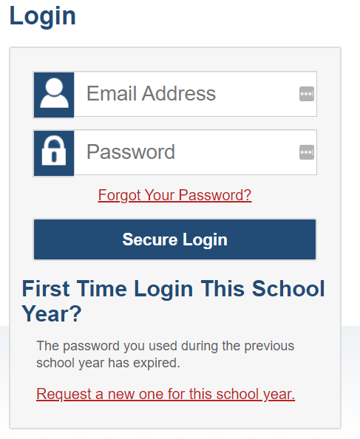
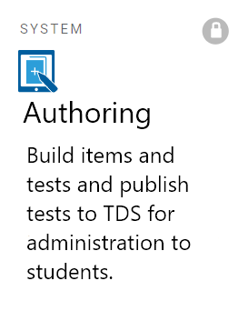
Logging in to the Authoring System
To access the Authoring system, navigate to your role card on the portal, and select the Authoring system icon under Preparing for Testing.
Notes:
To log in to Authoring, go to your state portal. From the portal, select your user role card. On the next page, click the Authoring system card. Enter your username and password, and then click Secure Login to continue.

Slide 5
Logging in to Authoring (continued)
The system has an authentication process that triggers when you log in from a different device or browser, or after clearing your browser’s cache.
If you see this screen, an email containing the code will be in your inbox.
Enter the code and click Submit.
If you need the code re-sent, click Resend Code.
Notes:
When logging in to the system using a new device or browser, or after clearing the cache on a previously used browser, you will see an Enter Code page.
If you see this screen, you will need to enter the code on this page within fifteen minutes of receiving the email. If you do not receive a code or do not enter the code within the fifteen-minute time limit, click Resend Code. Click Submit after entering the authentication code to access the system.

Slide 6
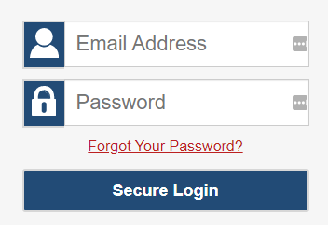
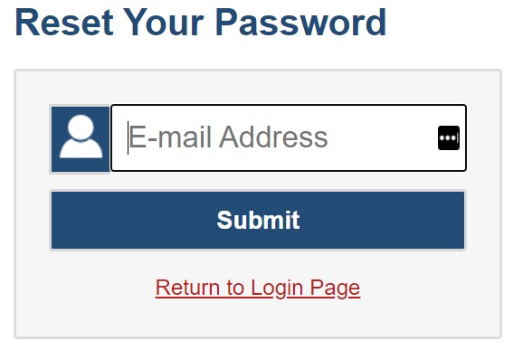
Resetting Your Password
DoNotReply@cambiumassessment.com
Notes:
You will need to reset your password in the following situations:
You forget your password.
Your activation link expired.
Your account is locked because you exceeded the account login attempt limit.
It is a new school year.
To reset your password, click the Forgot Your Password link. You will be taken to the Reset Your Password page. Enter your email address and click Submit. You will receive an email from DoNotReply@cambiumassessment.com with instructions to reset your password.

Slide 7
How to Navigate the Authoring Site
Notes:
This section explains how to use the quick links and the content tabs to find and create items and tests.

Slide 8
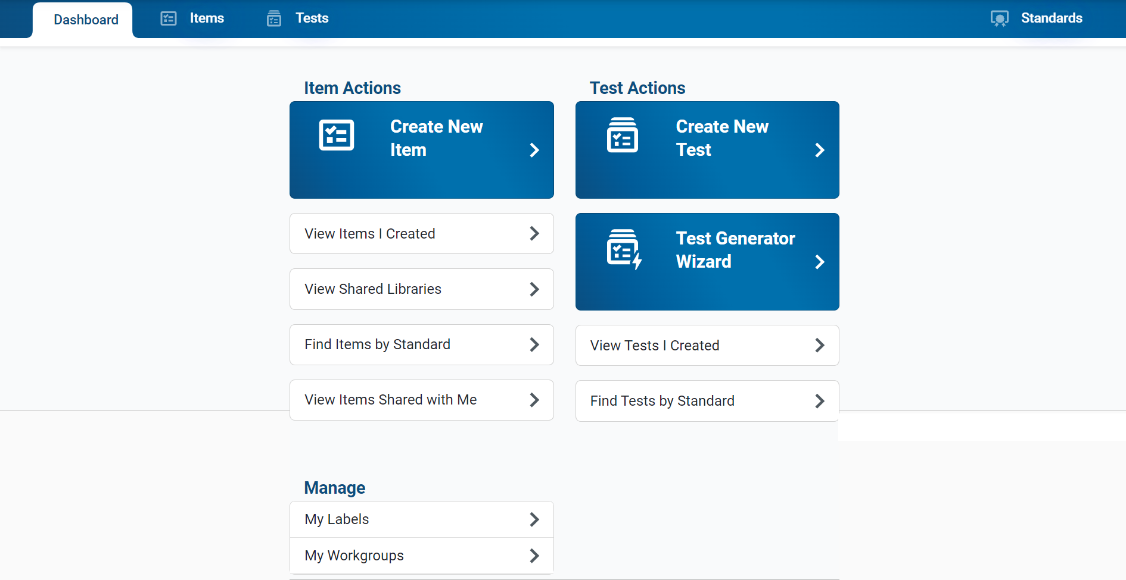
Dashboard Design
Content Tabs
Quick Links
Notes:
The Authoring site consists of a Dashboard with a content tab for each type of content you can work with: Items, Tests, and Standards.
It also displays quick links on the Items and Tests cards that you can click to jumpstart common tasks, such as creating items and tests and finding items and tests aligned with standards. You will need to apply filters in order to display the items.
The quick links are described on the next two slides.

Slide 9
Items Quick Links
Item Link | Description
Create New Item | Opens the item builder page where you can create a new item.
View Items I Created | Opens the Items tab, filtered to show you only your own items that were created or edited within the last 30 days.
View Shared Libraries | Opens the Items tab with the Libraries, Grade, and Subject filters expanded, allowing you to easily locate the items in a shared library, such as SAMPLE LIBRARY. Shared libraries consist of premade items provided by Assessment Program that you can add to your tests. You will need to apply filters in order to view these items.
Find Items by Standard | Opens the Items tab with the filter panel focused on the Standards search bar, so you can easily locate items aligned to a specific standard. You need to enter a standard name or key and click Apply in order to display the items.
View Items Shared With Me | Opens the Items tab, filtered to show you only the items that other Authoring users created and shared with you within the last 30 days.
Review Items | Opens the Items tab, filtered to show you only the items submitted to a shared library that still need to be reviewed and approved.
Notes:
On this slide you can read a quick description of what will open when you click on the various item links on the Dashboard.

Slide 10
Tests Quick Links
Test Link | Description
Create New Test | Opens the test builder page where you can create a new test manually.
Test Generator Wizard | Opens the test generator wizard, which allows you to automatically generate a new test based on the standards you want it to assess.
View Tests I Created | Opens the Tests tab, filtered to show you only your own tests that were created or edited within the last 30 days.
Find Tests by Standard | Opens the Tests tab with the filter panel focused on the Standards search bar, so you can locate tests with items aligned to a specific standard. You will need to enter a standard key and click Apply in order to display the tests.
Notes:
On this slide you can read a quick description of what will open when you click on the Tests quick links on the dashboard.

Slide 11
General Management Links
Link | Description
My Labels | You can create and manage labels you can use to organize your items and test.
My Workgroups | You can create and manage workgroups, which are groups of users who regularly share items and tests with each other.
Notes:
On this slide you can read a quick description of what will open when you click on the various general management links on the Dashboard.

Slide 12
How to Use the Content Tabs to View Items, Tests, and Standards
Notes:
This section covers how to use the content tabs on the dashboard to view items, tests, and standards.

Slide 13
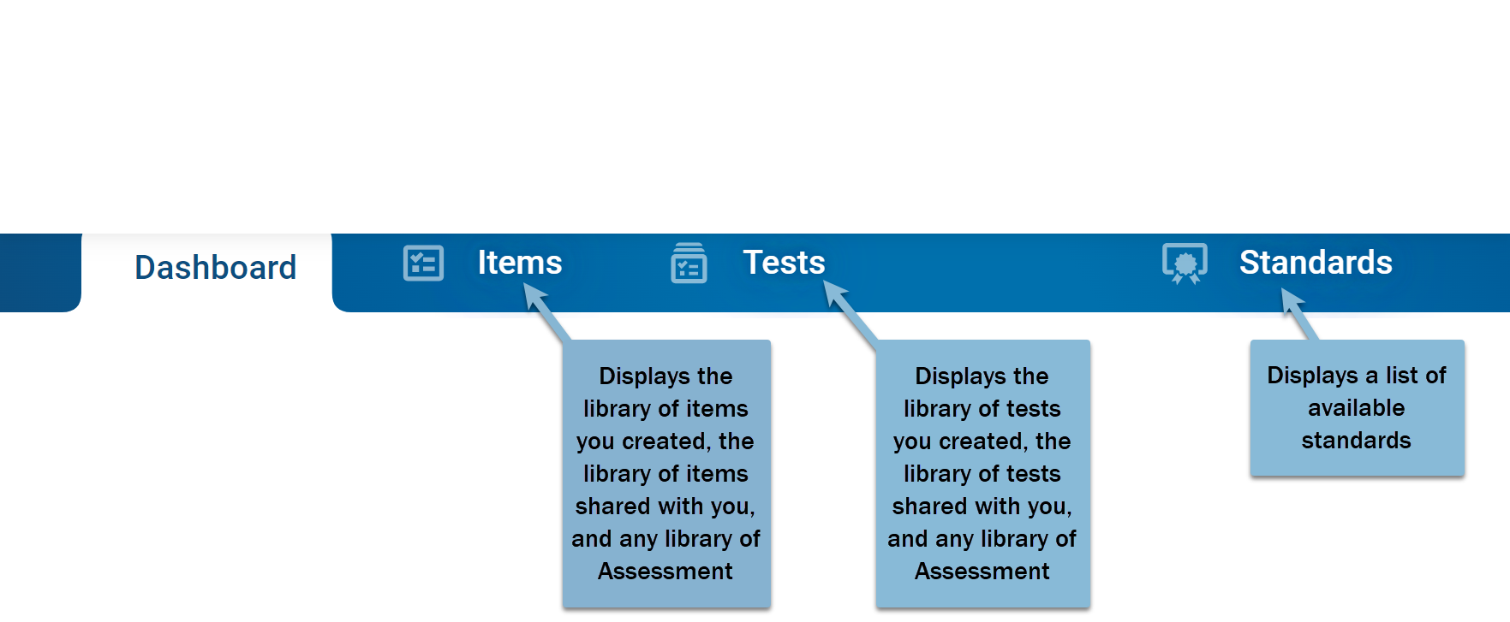
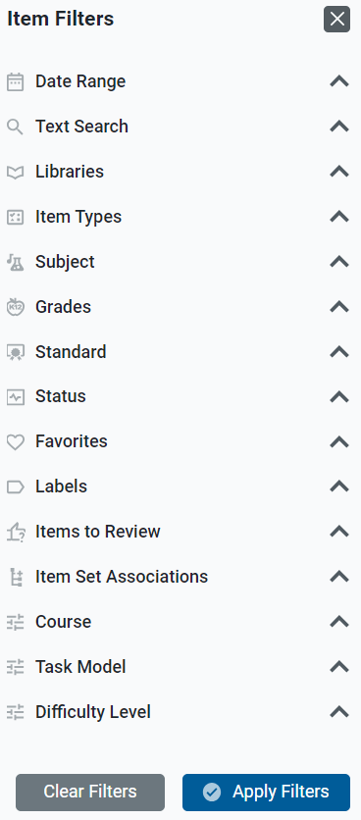
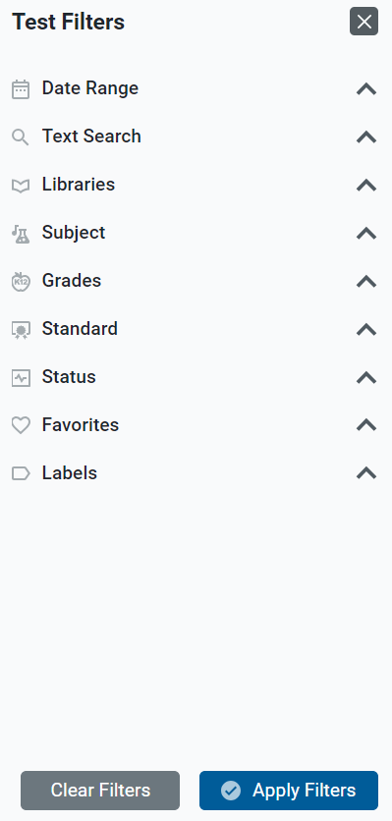
Content Tabs
Notes:
The Dashboard includes content tabs at the top to help you access your items, tests, and standards. A table of results will display from the library of items or tests you created, the library of items or tests shared with you, and any library of Assessment Program items or tests. The Standards tab displays a list of available standards publications and is useful for locating items and tests that are aligned to a particular standard.
It is helpful to use the filter options that display when you click a content tab. Here you can see the item filter options and the test filter options under the Dashboard banner. The message on the page reminds you to choose your filter options and select Apply to view the results table.

Slide 14
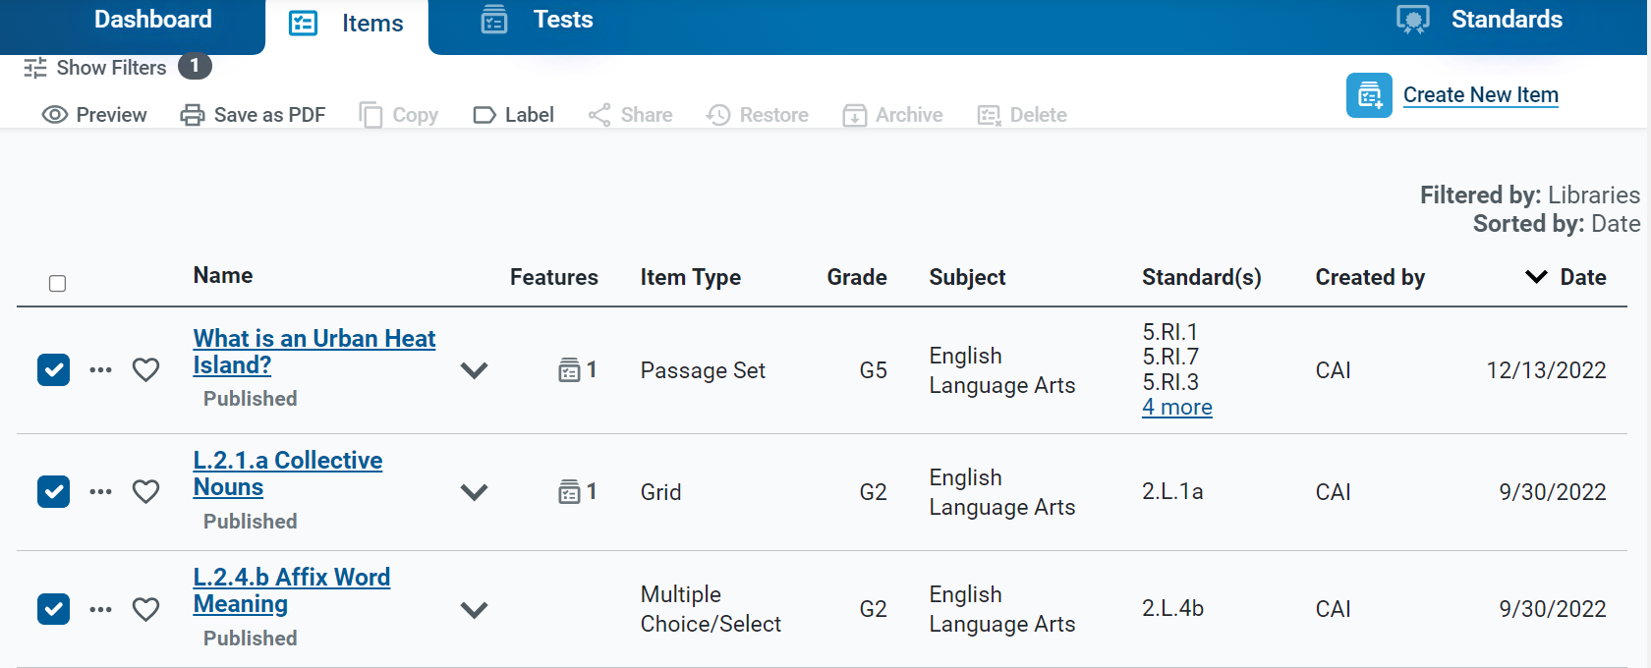
Items Content Table
Items Toolbar
Notes:
Here is an example of an items content table, filtered by Assessment Program library. The table provides details about the content available to you based on its subject, grade level, standards, and other properties. You can use the toolbar above each table to perform actions on your items. Click the expansion arrow to display a description of the item, its standard alignment, and other information.

Slide 15
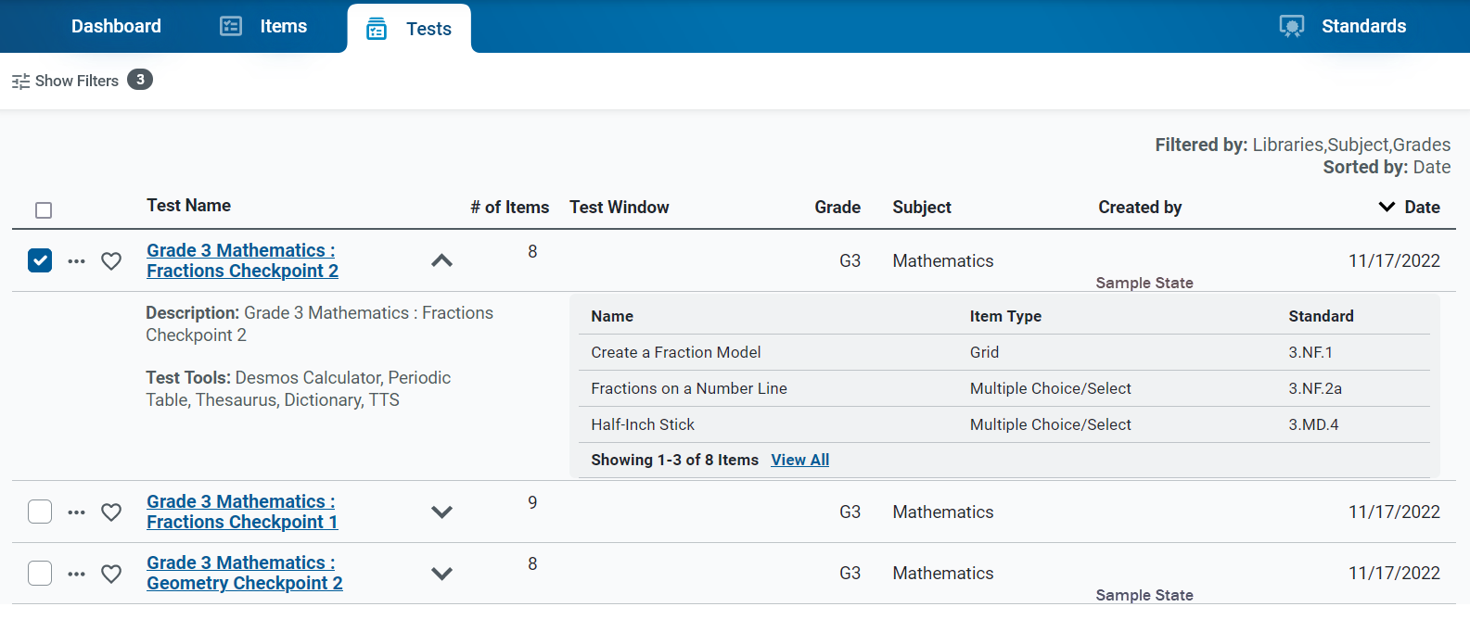
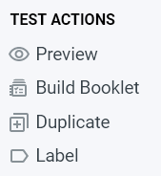
Tests Content Table
Notes:
Here is an example of a tests content table, filtered by libraries, subject, and grade. The details under the expansion arrow include a description of the test, the test tools assigned to it, and a list of the items included on the test. Click on the dotted icon to display a list of test actions, such as Preview, Build Booklet, Duplicate, and Label.

Slide 16
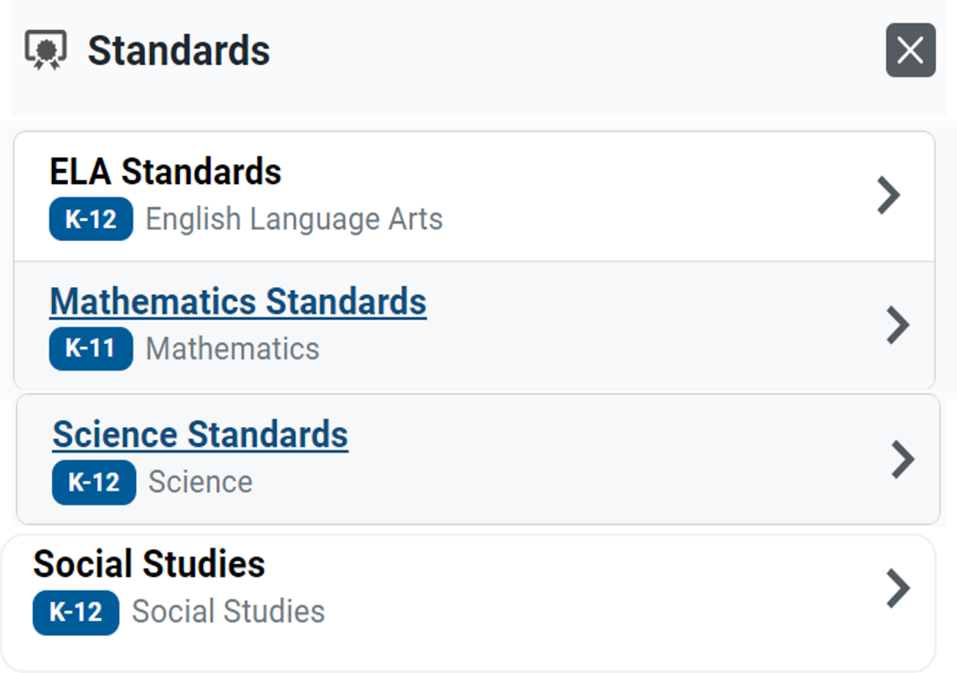
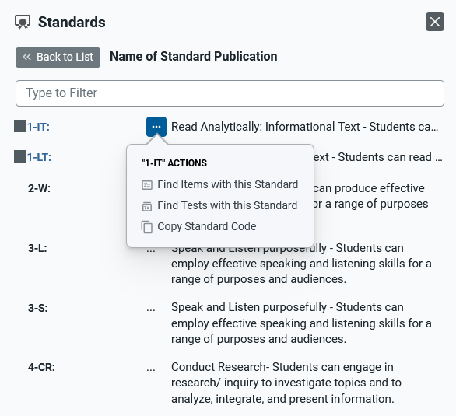
Standards Panel
Notes:
Here is an example of the Standards panel showing the standards tree for ELA, Mathematics, Science, and Social Studies. Expand the standard categories until you locate the standard you are looking for. You can also search for the standard at the top of this panel in the Type to Filter field. To use the actions options, click the dotted menu to the left of a specific standard. Options include: Find Items with this Standard, Find Tests with this Standard, and Copy Standard Code.
Standards identify the specific skills or areas of knowledge that an item measures. Aligned standards will appear in the reports for Authoring tests, helping you pinpoint the specific areas in which a student may be excelling or may need additional support.

Slide 17
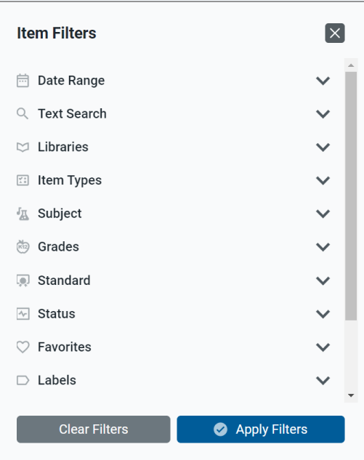
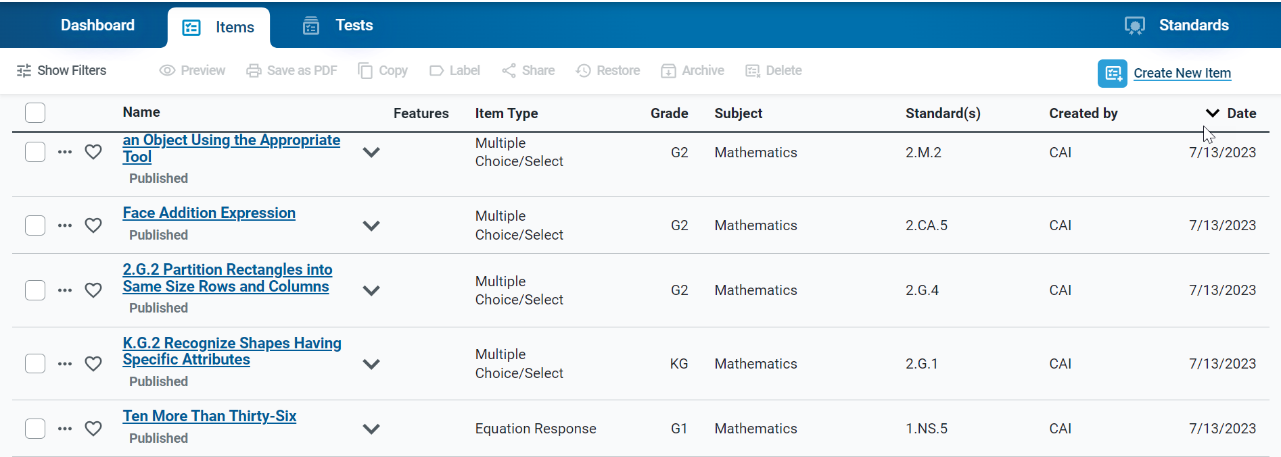
Assessing Items with the Content Tab
F
i l
t
e
r
P a n e l
Content Tabs
Toolbar
Notes:
The Items content tab allows you to manage your existing items, as well as create new items. A filter panel beside the table helps you locate specific content based on its date range, item type, subject, grade level, or other properties. You can also use the toolbar above the table table to perform actions on your items, such as previewing the item, creating copies of them, printing them as PDFs, or sharing them with other users.
Note that in some cases, the tables on the Items tab will not display until you select filter options from the panel on the left and click Apply.

Slide 18
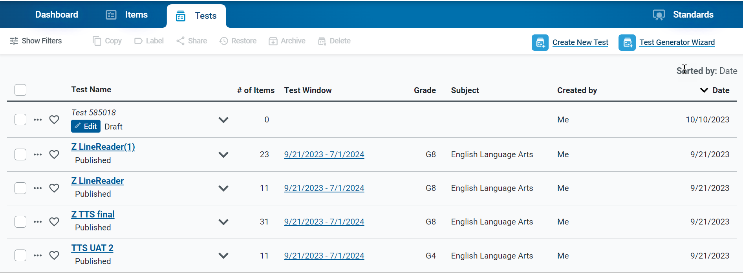
Assessing Tests with the Content Tab
Notes:
The Tests content tab allows you to manage your existing tests, as well as create new tests. A filter panel beside the table helps you locate specific content based on its subject, grade level, or other properties. You can also use the toolbar above the table to copy, label, share, restore, archive, delete, or administer a test.
Note that in some cases, the tables on the Tests tab will not display until you select filter options from the panel on the left and click Apply.

Slide 19
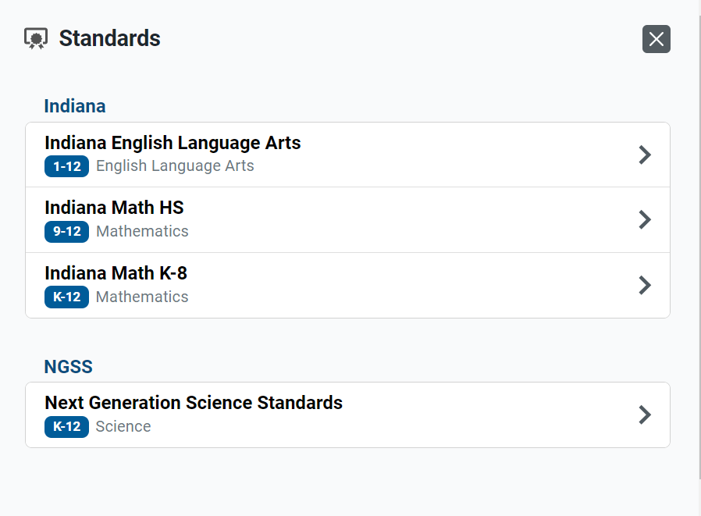
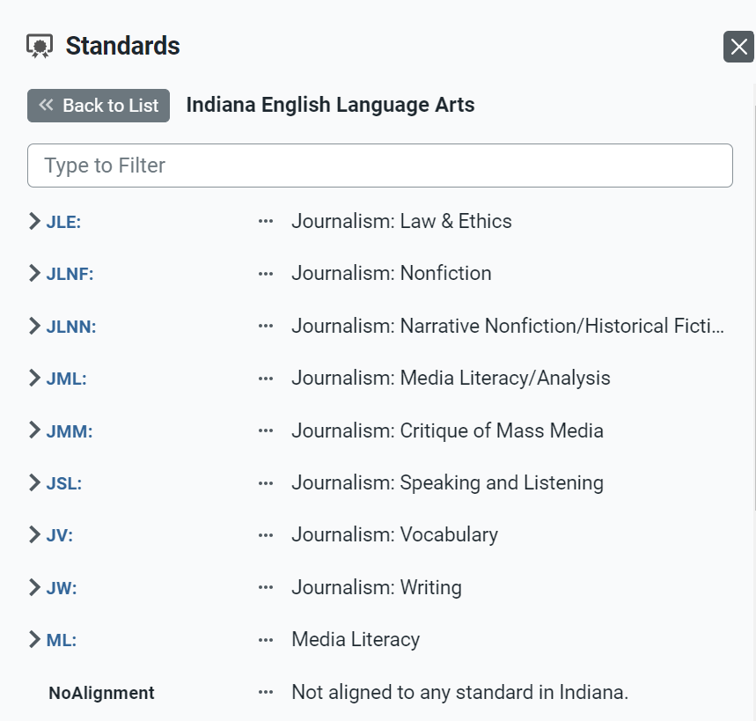
Previewing Standards with the Content Tab
Notes:
The Standards content tab displays standards publications provided by your Assessment Program. You cannot create or modify standards publications, but you can preview them to see the keys for the individual standards. Knowing the right standard key can be helpful when aligning items to standards or when filtering the content tabs by standard. When you find the key you need it’s a good idea to write it down for future reference.

Slide 20
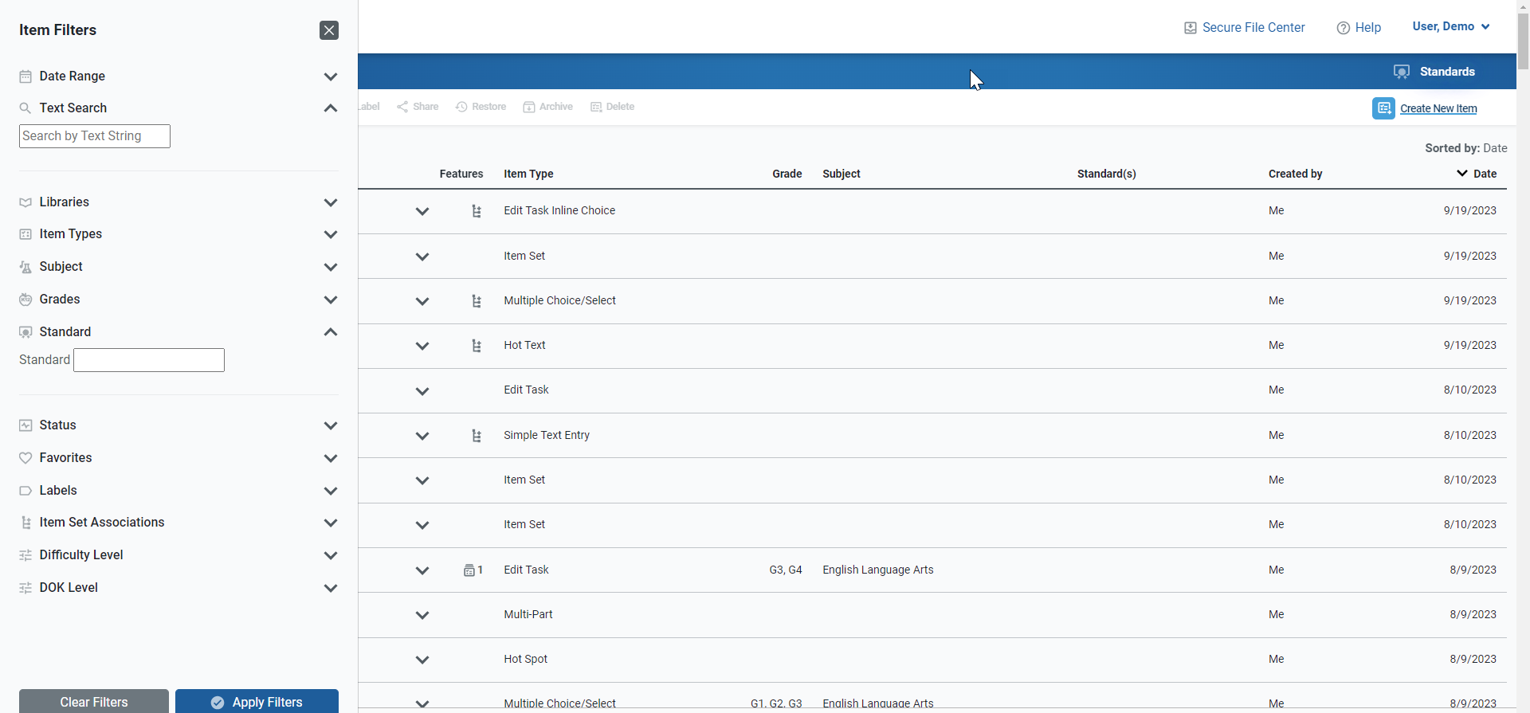
Search Bar and Filters Panel
Text Search
Standard Search
Notes:
Each content tab includes a filter panel to help you find the items, tests, or standards you want to work with. The available filter options are different for each content type, but their use is similar.
To search for items or tests, enter a term in the search field in the filters menu and click Apply. Any item or tests that contain that term in their name, content, or properties will display in the table of results.
If you need to search for content aligned to a particular standard, you should use the Standard search field. It’s helpful to use the Standards content tab to find the quick key identifier (such as “A-APR.1”) and type it into the Standard search field.

Slide 21
How to Use Filters for Items and Tests
Filter | Content Tab | Use
Date Range | Items and Tests | Expand the Date Range menu to mark a checkbox to view only the items or tests that were created, edited, or added to a shared library in the selected time period, or use a custom time period.
Text Search | Items and Tests | Expand the Text Search menu to located items or tests that contain a specific term in their name, content, or properties.
Libraries | Items and Tests | Expand the Libraries menu to filter your content results by items and tests you created, items and tests shared with you, or content in a shared library.
Subjects | Items and Tests | Expand the Subject menu and mark the available checkboxes to view only the content associated with a particular subject.
Grades | Items and Tests | Expand the Grades menu and mark the available checkboxes to view only the content associated with that grade.
Standard | Items and Tests | To show only content aligned to a particular standard, enter the ID or label for a standard in the Standard field. Items are aligned to standards directly, while a test’s standards are determined by the items on that test.
Status | Items and Tests | Expand the Status menu and mark the available checkboxes to view only the content with a particular status. Some common status terms include Draft, Published, and Archived.
Notes:
This table is a summary of the filter options available on the Items and Tests tabs.

Slide 22
How to Use Filters for Items; and for Items, Tests and Standards
Filter | Content Tab | Use
Item Type | Items | Expand the Item Type menu and mark the available checkboxes to view only the items that are built in a particular item template.
Stimulus Associations | Items | Expand the Stimulus Associations menu and mark the available checkboxes to view only items that are linked to a stimulus or only items that are not linked to any stimulus.
Items to Review | Items | Mark this checkbox to show only the items that have been submitted to a shared items library and still need to be approved.
Advanced Filters | Items | Click Advanced Filters to open a pop-up window that allows you to select additional filter criteria, such as the Course, Task Model, or Difficulty Level associated with the item.
Labels | Items, Tests, Standards | Create custom labels to organize content. Expand the Labels menu and mark the available checkboxes to view only the content associated with a particular label.
Favorites | Items, Tests, Standards | Click the star icon next to any item, test, or standard to save it as a favorite. Mark the Favorites checkbox to show only the content you have marked.
Notes:
This table is a summary of the filter options available for Items only; and the filter options available on all three tabs: Items, Tests, and Standards.

Slide 23
How to Create Original Items for Your Tests
Notes:
This section explains how to create original items by filling out templates in the item builder page.

Slide 24
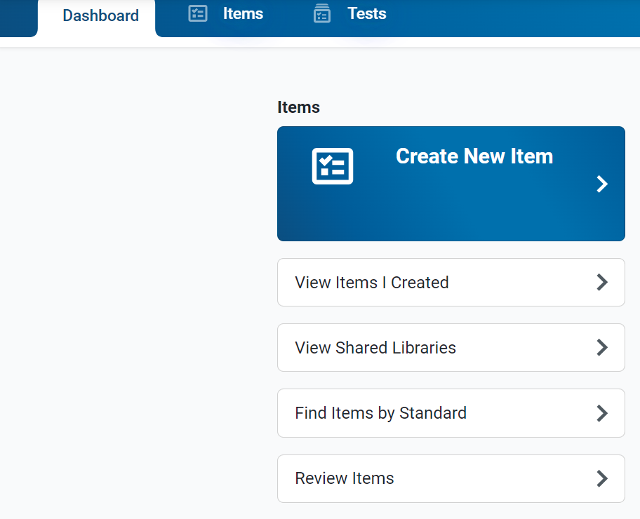
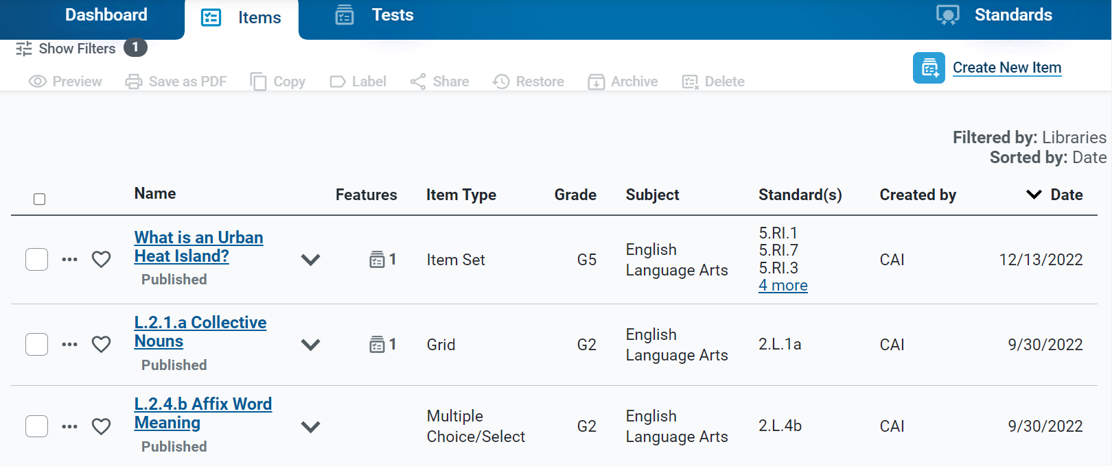
Create New Items
Click the Create New Item link
Click the Create New Item button.
Notes:
To create a new item, click on the Create New Item link on the Dashboard or open the Items content tab and click the Create New Item button.

Slide 25
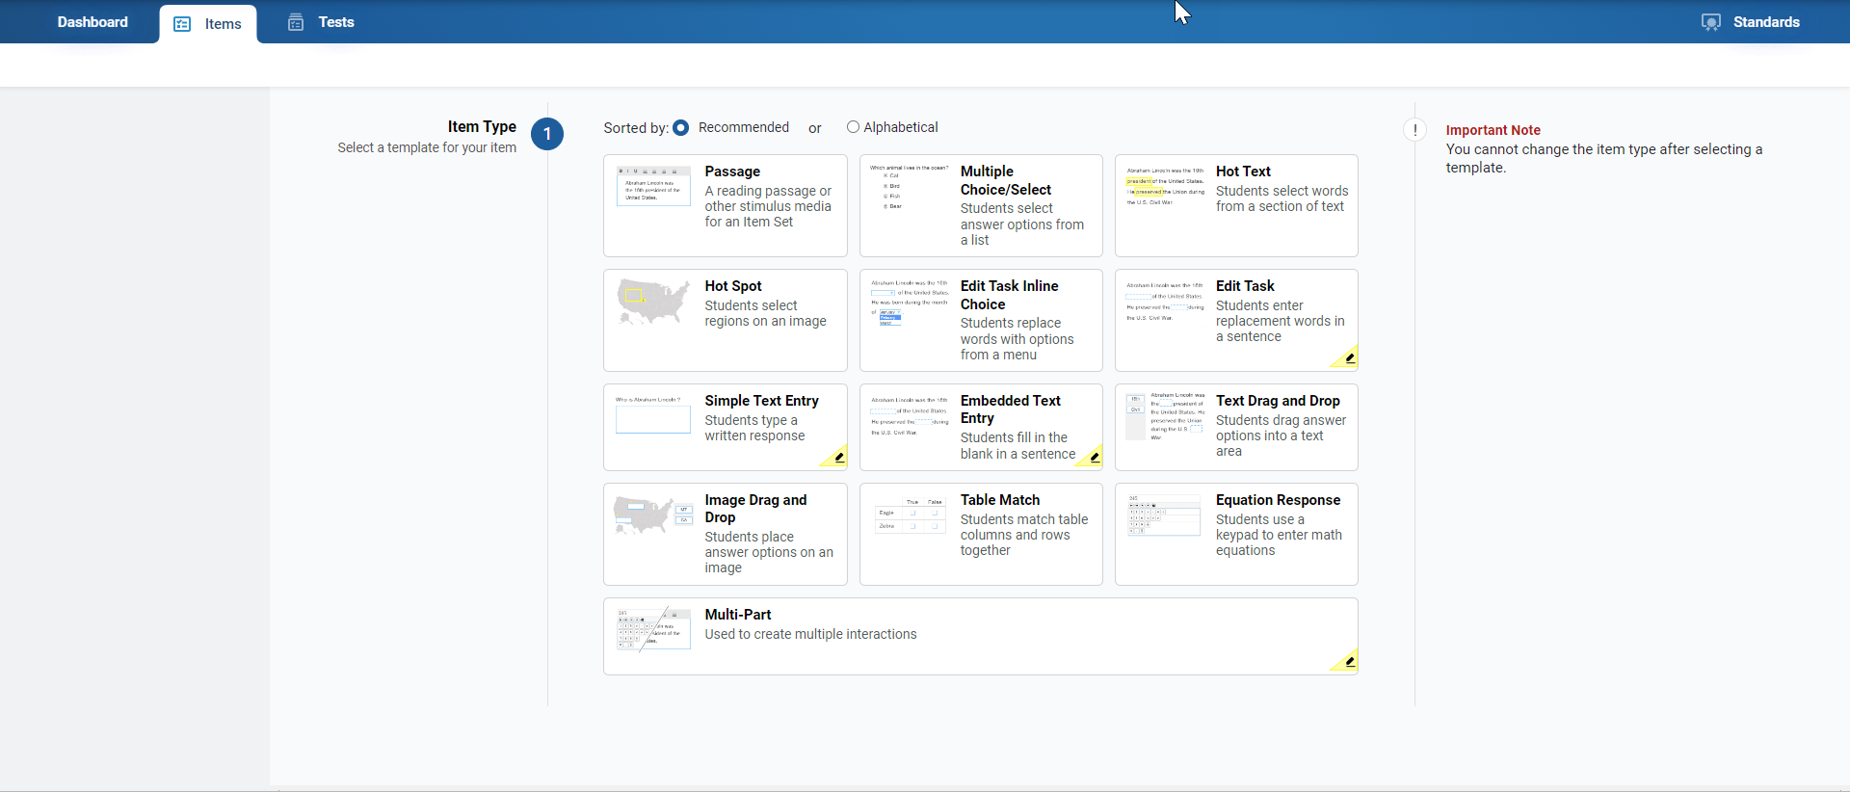
Item Builder—Template Options
Notes:
A collection of item types will display. Those displaying an edit icon, which looks like a pencil, need to be scored by hand in the Reporting system. You can hover over a template to read a description of the item type. Click the item type template for the one you want to create. You can arrange the collection alphabetically or by default recommended order of common types.
There are many different item types available. All of them involve three main steps, except for the stimulus template, which doesn’t require a response area or answer key. The item types are Stimulus, Multiple Choice/Select, Hot Text, Hot Spot, Edit Task Inline Choice, Edit Task, Simple Text Entry, Embedded Text Entry, Text Drag and Drop, Image Drag and Drop, Table Match, Equation Response, and Multi-Part.

Slide 26
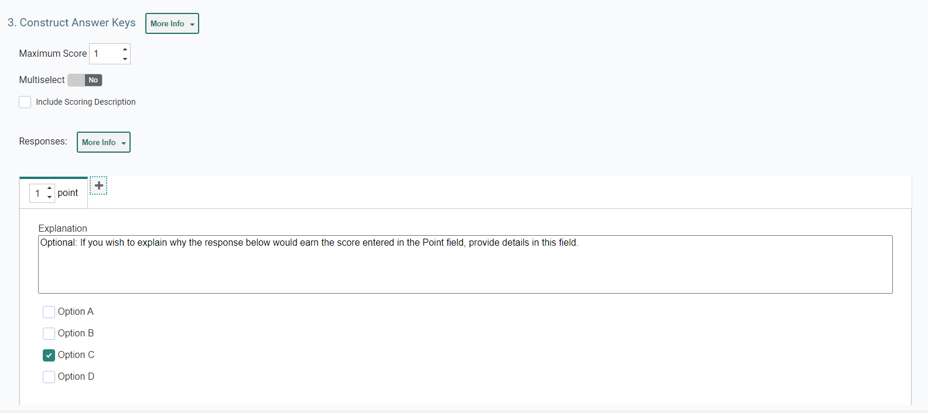
Item Builder—3 Main Steps
Notes:
Here you see the three steps on the item builder page. Step one: composing the item prompt, step two: creating the response area, and step three: constructing answer keys.
The Compose Item Prompt section is where you build your question or write the directions students will follow to respond to an item. Enter the prompt in a text box at the top of each template. You can use the toolbar in the text box to format the text and insert media elements, such as images, videos, and tables.
Sections two and three are explained on the next several slides.

Slide 27
Step 2: Create the Response Area
The response area of the item is where the students interact with various interactive features in order to answer the question. The areas are different for each item type.
Notes:
The response area of the item (step two) is where students interact with various interactive features in order to answer the question or respond to the stimulus. Response areas are different for each type of item template available. Items may require students to select an answer from a list of options, type a response in a text box, enter an equation with an on-screen keypad, drag and drop answer options onto an image or chart, and more. When you click the More Info button, instructions for completing the section will drop down, along with a link that takes you to that portion of the system User Guide.
This image shows the Create Multiple Choice Options section where you can add a rationale for each answer option and add options by clicking the Add Option button at the bottom of the section.

Slide 28
Step 3: Construct the Answer Key
Determine how many points an item is worth and how to score the student’s response.
Machine-Scored Items
Hand-Scored Items
Notes:
The answer key section is used to determine how many points an item is worth and how the student’s response will be scored. For machine-scored items, the section shows a preview of the item’s response area, where you should enter a valid response and select the number of points (Maximum Score) the response is worth. To allow points for a partially correct answer, click on the Add Tab button, which looks like a plus sign, and create more answer keys. You can explain each valid response in the Explanation box. The Include Scoring Description checkbox lets you add a reader-friendly description of the scoring criteria and an example of a valid response, which will be available in Reporting for this item.
For hand-scored items, the answer key section displays a Description field where you can enter scoring criteria and an Exemplar field where you can enter reader-friendly examples of valid responses for each score a student may earn. This information is used in Reporting, where student responses for the item will be scored by hand.

Slide 29
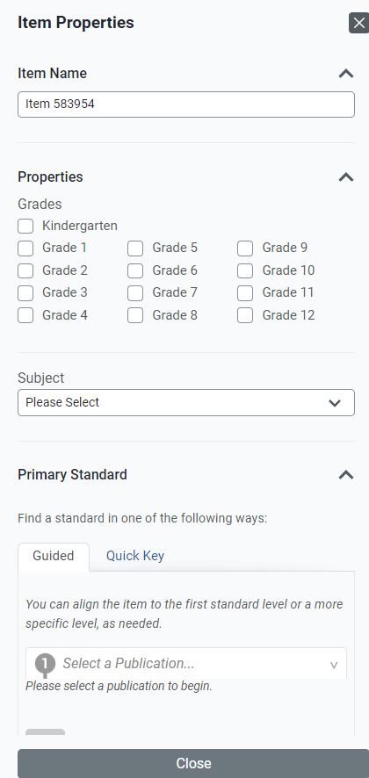
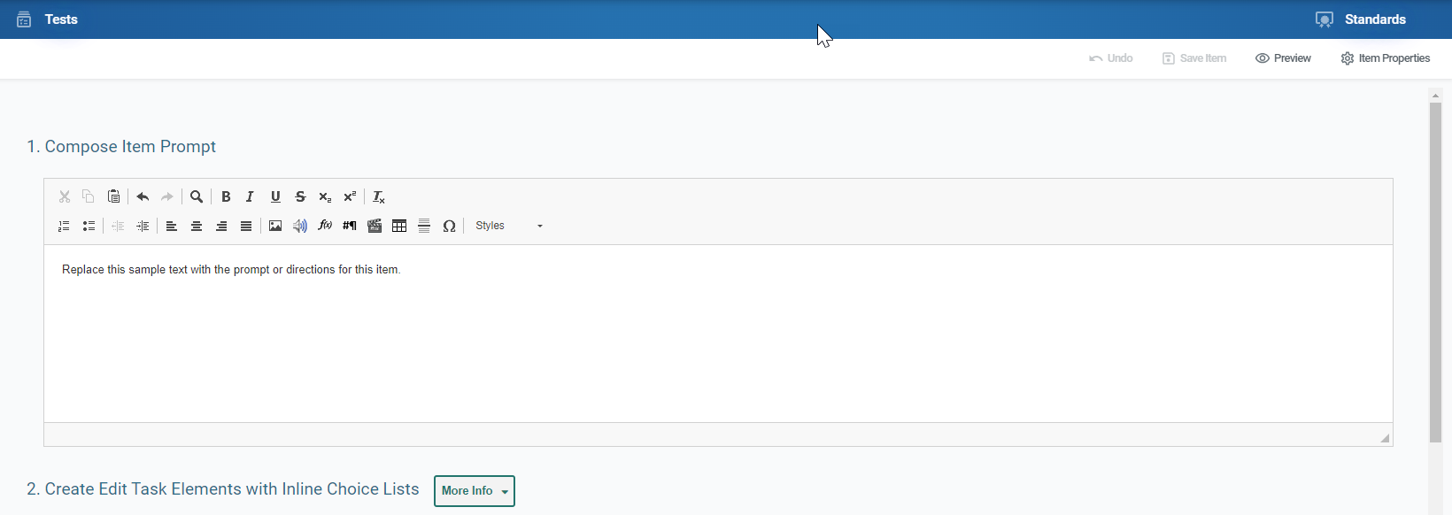
Item Toolbar
Notes:
At the top of the window, you will see an item toolbar. This toolbar allows you to perform tasks such as adding item properties, previewing an item, saving an item, and submitting an item for review.
The Item Properties button allows you to enter item details such as its name, grade, subject, and standard.
The Preview Button allows you to preview how your item will appear.
The Save Item button saves your item to your Items library with a Draft status. Your library items can be added to tests or shared with other users.
The Save as PDF button allows authorized users to create a printable version of an item, with or without scoring guidelines in the printout.
The Undo button opens a popup window displaying previous drafts of the item.

Slide 30
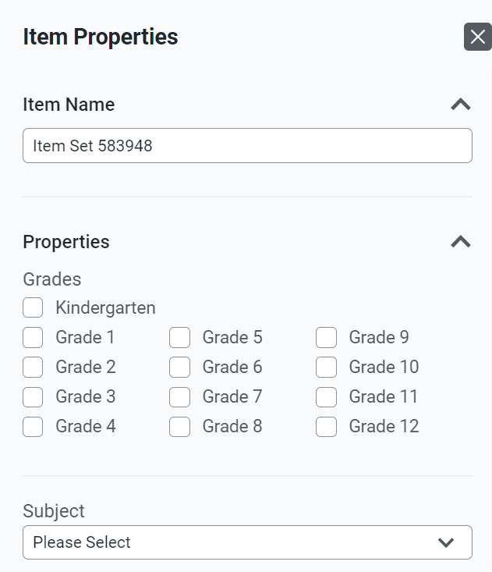
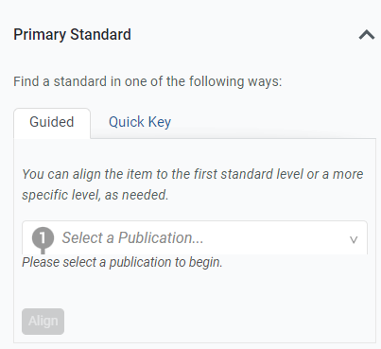
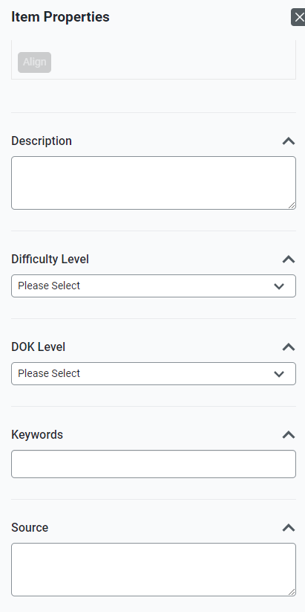
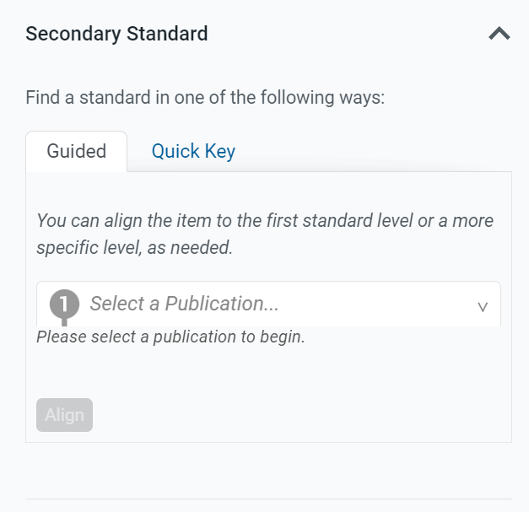
Aligning Standards & Setting Up Properties for Items
Notes:
You can use the Item Properties menu in the item toolbar to align your items to standards and to enter other helpful details, such as the subject and grade levels an item belongs to.
Standards identify the specific skills or areas of knowledge that an item measures. Aligned standards will appear in the reports for Authoring tests, helping you pinpoint the specific areas in which a student may be excelling or may need additional support. The properties you set up for items also make it easier to filter items when adding them to tests or locating them in the Items tab.
Item properties can be entered at any point while an item has a Draft status. However, once an item is added to a test and the test is published, the item status changes to Published and its properties will be locked, along with its content.

Slide 31
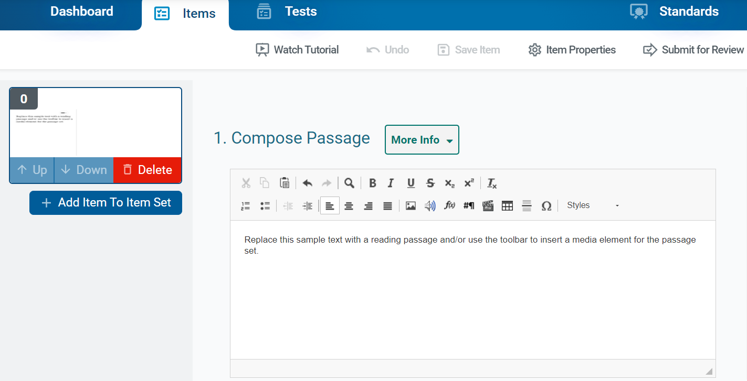
Passage Set — Groups Items Together
Notes:
The Passage Set template allows you to create a reading passage or other type of media, such as an image or video, that students will view in order to answer additional items that are linked to the set. For example, you can create a reading passage about a historical event and link it with items that will evaluate the students’ understanding of that event.
You can group multiple items in a passage set on a single test page. The passage or media element in a passage set does not include a response area or an answer key, but the items you link with it do.
To fill out the template, enter the content for the passage or other media type in the provided text box. You can use the toolbar in this box to format the text and insert media elements.
In the item toolbar above the template, click Save Item.
To create items to link with the stimulus, click the Add Item to Item Set button, which looks like a plus sign, to the left of the template. Then select an item type to proceed with adding the item. Note that you cannot link a stimulus with another stimulus. You can enter the content for the linked item by following the instructions for the appropriate item type, as presented later in this module. You can add more items, as necessary. You cannot link a stimulus to an original item that already exists in your libraries.

Slide 32
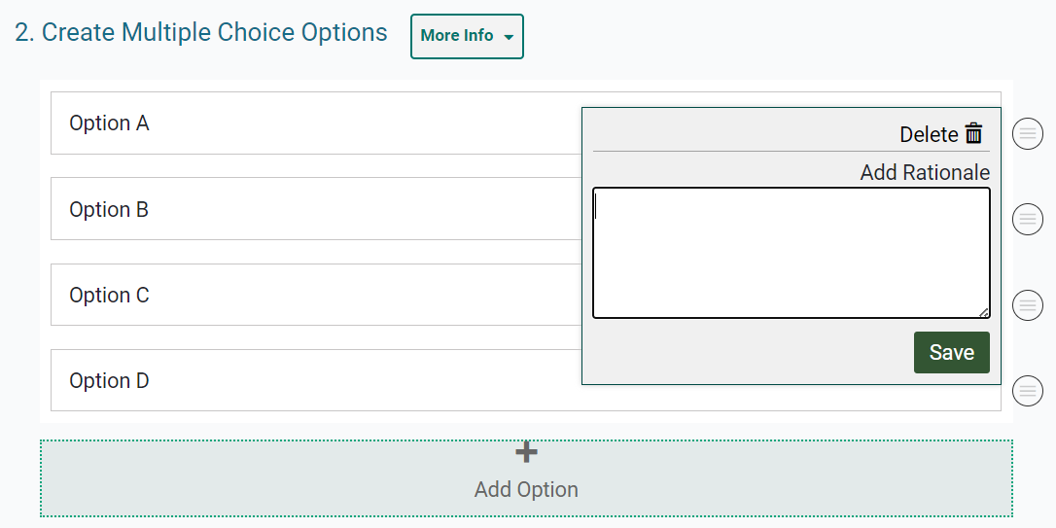
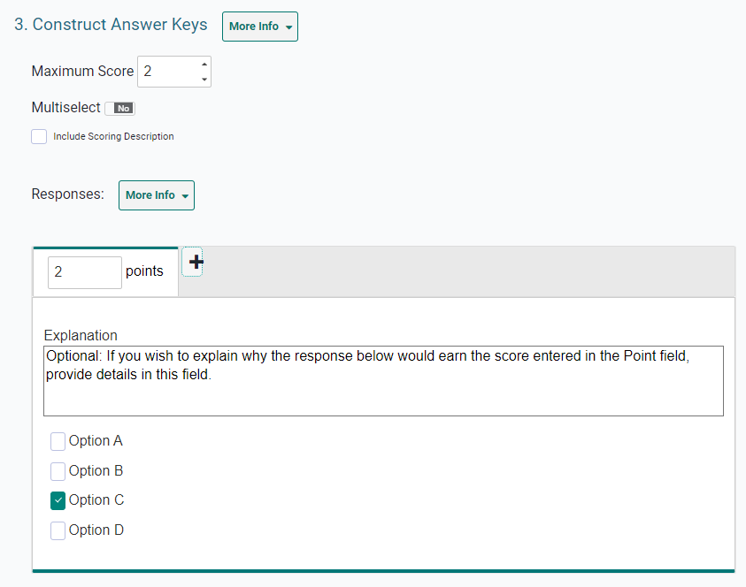
Multiple Choice and Multiple Select Items
Notes:
Multiple Choice/Multiple Select items requires students to select a single option or multiple options from a list of possible answer options.
To fill out the template, replace the sample text with the item’s question or directions in the Compose Item Prompt section. In the Create Multiple Choice Options section, sample response options are already provided. You can click each option to replace the sample text with the desired text for that response option.
If you want to add additional response options to the item, click Add Option and then enter the content for the new option that appears. To remove an option, click the menu button beside it and then click Delete. If you want to enter the rationale for why a response option is correct or incorrect, click the menu button beside it, then enter a description in the Add Rationale field and click Save.
In the Construct Answer Keys section, enter the item’s highest possible score in the Maximum Score field. If you want to allow students to select more than one response option, set the Multiselect toggle to Yes. Then specify the maximum number of options they can select in the Maximum Selections field. To create answer keys for the item, do the following: In the Points field, enter the score for a correct or partially correct response. Note that if a sample response is already entered, you may need to clear its checkbox first. Then, in the provided response area, select the response options that students would need to select in order to earn the score you entered in the Points field. You can add an explanation for the correct answers in the Explanation field above the answer options.

Slide 33
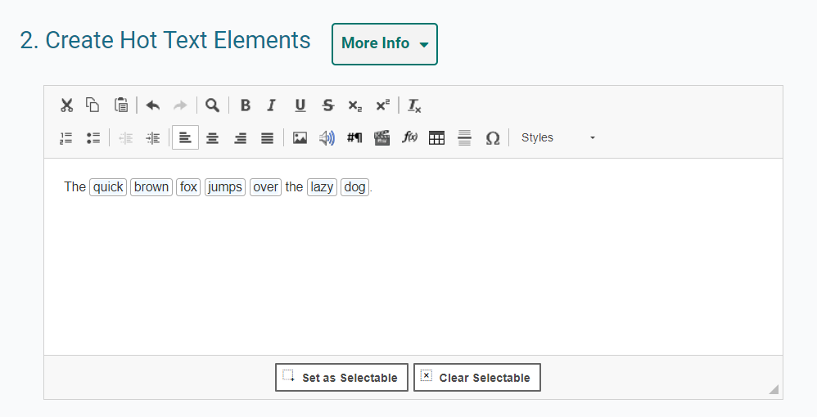
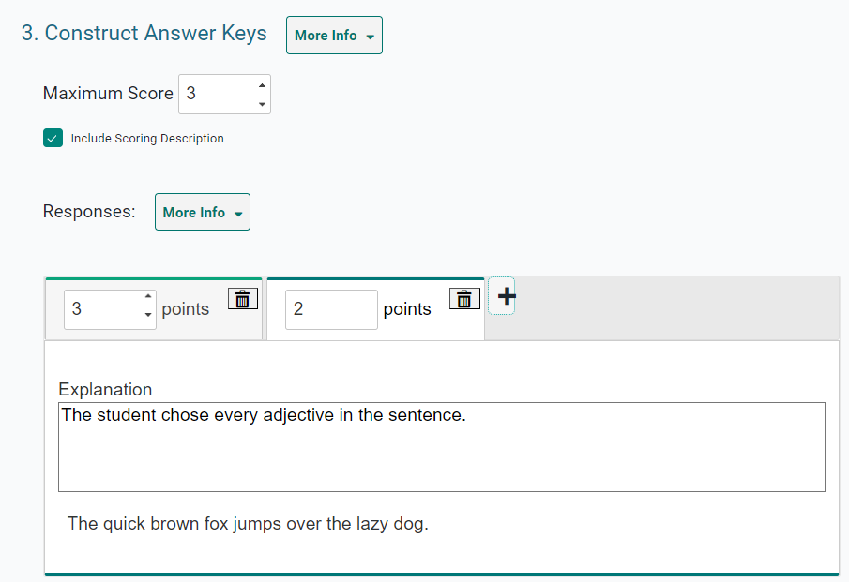
Hot Text Items
Notes:
Hot Text items require students to select words or phrases in a section of text. The words and phrases appear shaded when students select them. For example, a Hot Text item might provide a sentence and ask students to select all the adjectives in it.
In the Compose Item Prompt section, replace the sample text with the item’s question or directions.. The Create Hot Text Elements section displays sample text, including selectable words. Delete this sample text and enter new text containing the words or phrases students will select.
To tag a word or phrase that will be selectable to students, do the following: First, click and drag the cursor across a word or phrase to highlight it. Next, click Set as Selectable below the text box. A border appears around the selected word. If you need to untag a word you marked as selectable, click that word and then click Clear Selectable.
In the Construct Answer Keys section, enter the highest possible score in the Maximum Score field. To create answer keys for the item, do the following: In the Points field, enter the score for a correct or partially correct response. Then, in the provided response area, click the words or phrases that students would need to select in order to earn the score you entered in the Points field.

Slide 34
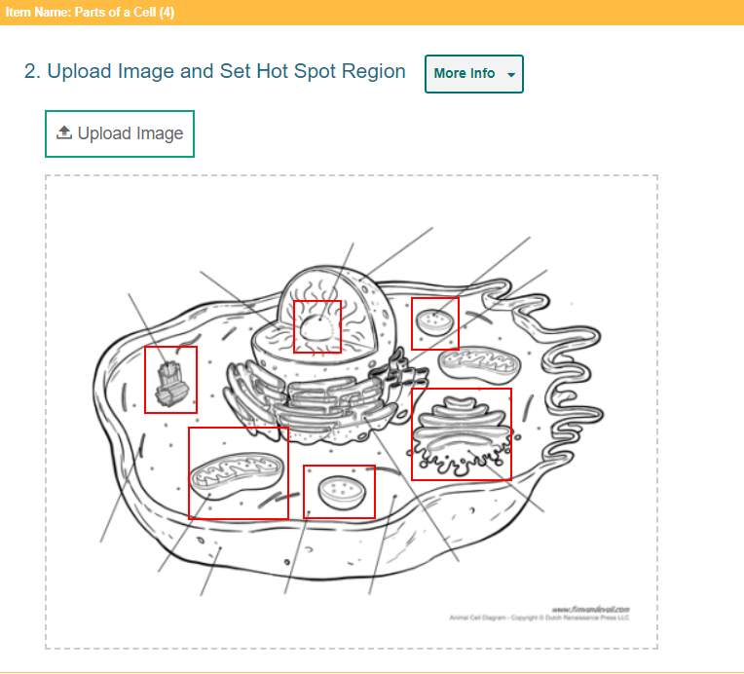
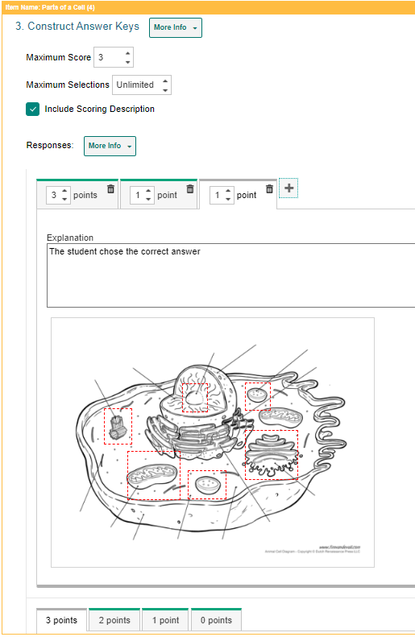
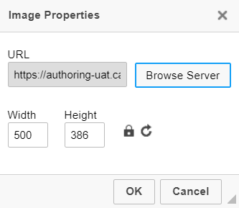
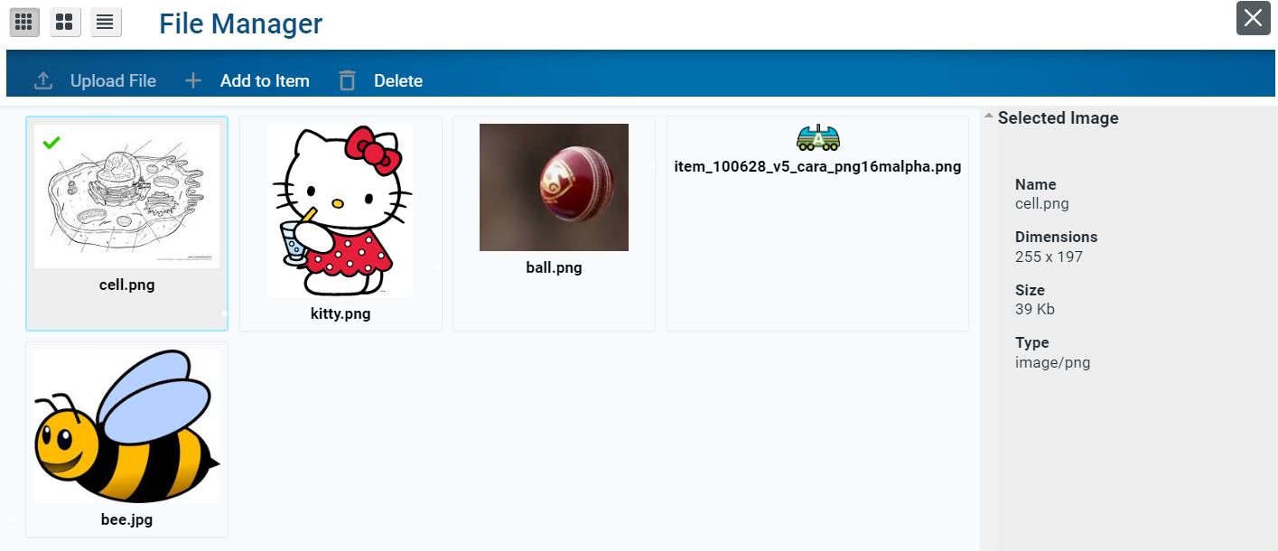
Hot Spot Items
Notes:
Hot Spot items require students to select one or more clickable regions on an image. A rectangular border appears around each region the students select. For example, a Hot Spot item can show a diagram of an animal cell and ask students to identify the parts.
First, in the Compose Item Prompt section, replace the sample text with the item’s question or directions. Next, in the Upload Image and Set Hot Spot Region section, upload an image for the item. To do so, click Upload Image. In the Image Properties window, click Browse Server. If the image you want to use for the item is already available in the File Manager window, select it and click Add to Item. You can use the search bar in the corner to search for an image by its file name. If the image you want to use is not available in the File Manager window, click Upload File and select an image file from your computer. Then select the image and click Add to Item. The image must be 600×600 pixels or smaller and under 1.5 MB. In the Image Properties window, click OK.
Next, to create the selectable regions on the image, do the following: Click the image once to set the first corner of the selectable rectangle, then click one more time where you want to set its opposite corner (do not click and drag). A red box appears, but this will not be visible to students. To move a selectable region, click that region and drag it to the desired location. You can copy or delete a selectable region by selecting that region's box and then clicking Copy or Delete.
In the Construct Answer Keys section, enter the highest possible score in the Maximum Score field. Optionally, to limit the number of hot spot regions students can select at a time, enter a value in the Maximum Selections field. To create answer keys for the item, do the following. In the Points field, enter the score for a correct or partially correct response. If a sample response is already entered, you may need to unselect that hot spot first. In the provided response area, click the image regions that students would need to select in order to earn the score you entered in the Points field.
More information on how to add images to items can be found on slides 27–37.

Slide 35
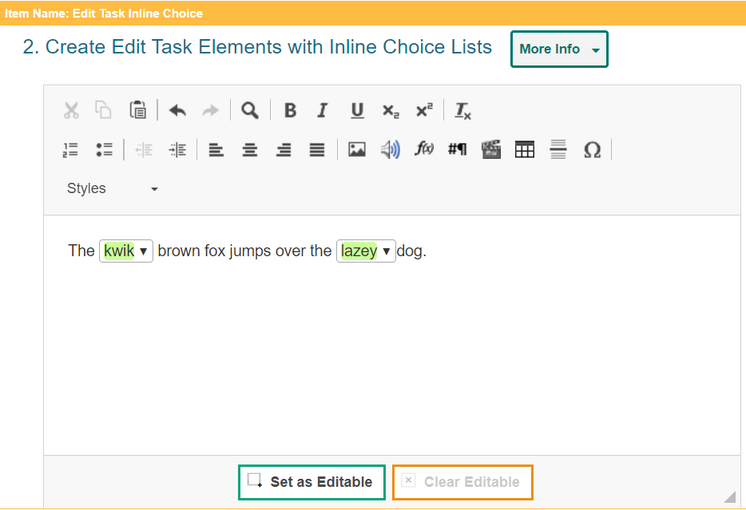
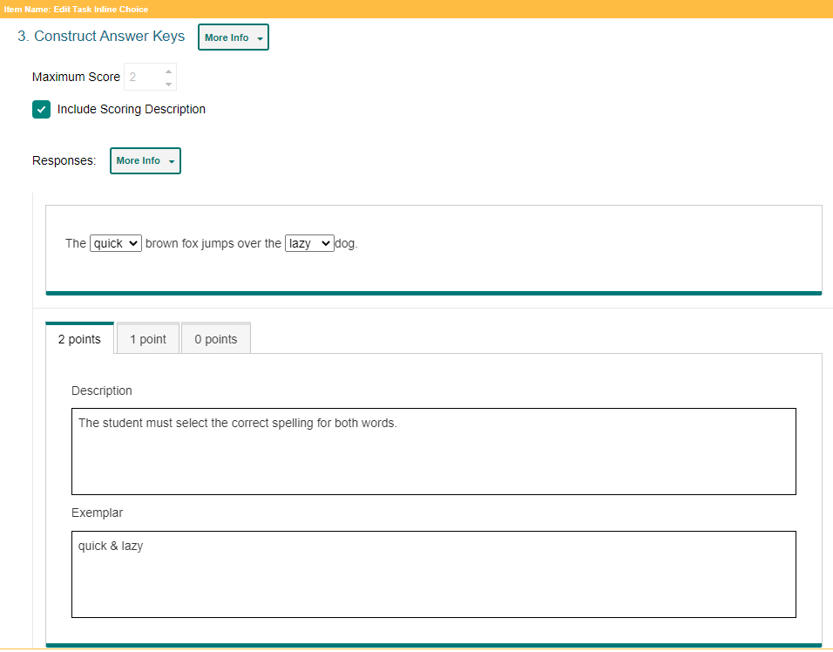
Edit Task Inline Choice Items
Notes:
Edit Task Inline Choice items provide a section of text in which one or more words appear as dropdown menus. Students select answer options from the dropdowns to replace the original words in the text. For example, an Edit Task Inline Choice item can provide a sentence with a misspelled word and ask students to select the correct spelling from the dropdown.
In the Compose Item Prompt section, replace the sample text with the item’s question or directions. The Create Edit Task Elements with Inline Choice Lists section displays sample text content, including an editable word. Delete this sample text and enter new content with the words that students will replace.
To tag a word or phrase that students will be able to replace, do the following: Click and drag the cursor across the desired word or phrase to highlight it. Click Set as Editable below the text box. A border appears around the selected word and the Inline Choice window appears. In the Inline Choice window, enter a replacement option for the tagged word in the blank text box. To add additional replacement options, click Add Option and enter the replacement option in the new text box that appears.
In the Construct Answer Keys section, the maximum score is automatically set based on the number of editable elements you created. You cannot customize this score. To create the item’s answer key, click the editable words in the sample response area and replace each one with the correct answer option. The item will automatically assign students the appropriate number of points for their response based on the number of correct selections they made.

Slide 36
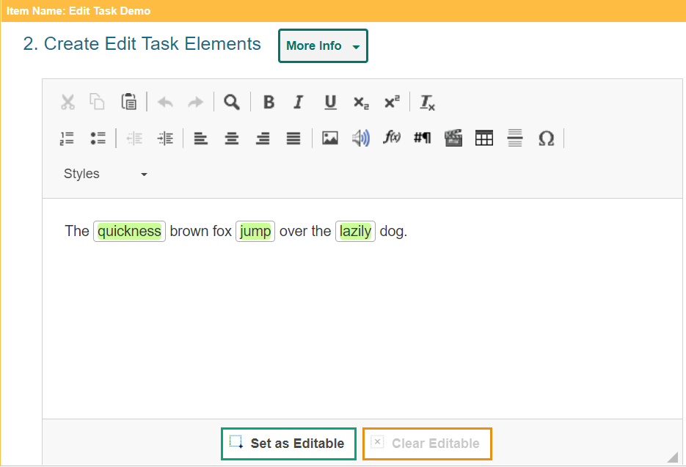
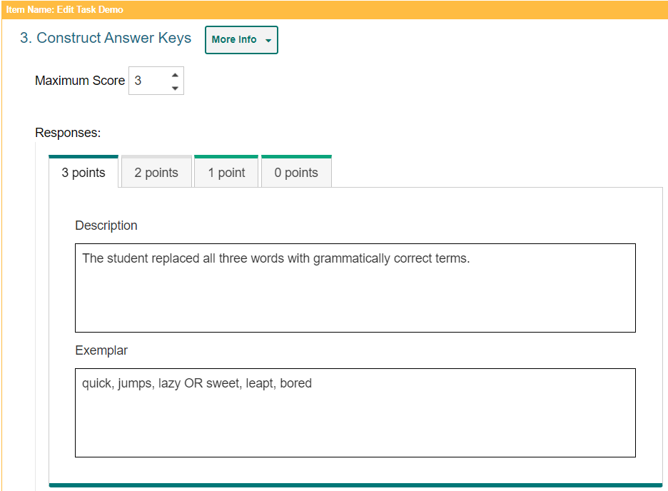
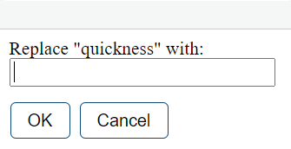
Edit Task Items
Notes:
Edit Task items require students to make edits to a specified word or phrase in a sentence or paragraph. Students can click each of these words or phrases to open a text box which allows them to type a replacement for the original text. These items must be scored by an authorized user in the Reporting system. For example, an Edit Task item can provide a sentence with a misspelled word and ask students to enter the correct spelling for it in a popup text box.
In the Compose Item Prompt section, replace the sample text with the item’s question or directions.
The Create Edit Task Elements section displays sample text content, including an editable word. Delete this sample text and enter new text content containing the words that students will replace. To tag a word or phrase that students will be able to replace, do the following. Click and drag the cursor across a word or phrase to highlight it. Then click Set as Editable below the text box. A border appears for the selected word.
In the Construct Answer Keys section, enter the item’s highest possible score in the Maximum Score field. Fill out the rubric for the correct, full-credit response for the item. In the Description field, describe how a student must respond to the item in order to earn full credit. In the Exemplar field, enter an example of a response that would earn full credit. Note that the template automatically creates a rubric tab for each possible score a student can earn, based on the maximum score. To fill out any additional rubrics for the item, click the tab for that rubric and enter a description and exemplar for the rubric’s score.

Slide 37
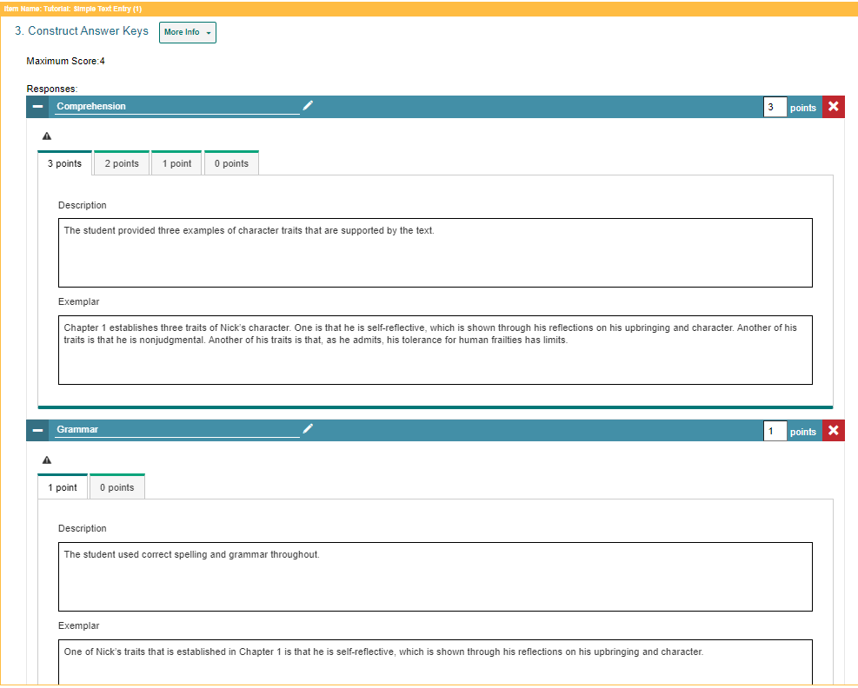
Simple Text Entry Items
Notes:
Simple Text Entry items require students to type a written response in a provided text box. You can choose what kind of toolbar to include in the text box. For example, a Simple Text Entry item might ask students to write a short essay about their favorite historical figure. Note that these items must be scored by a user in the Reporting system.
In the Compose Item Prompt section, replace the sample text with the item’s question or directions. You can use the toolbar to format the text and insert media elements. To specify the height of the students' text box, enter a value in the Number of Rows in Text Box field. To specify the type of toolbar that will be available to students, select an option from the Text Editor to Show Student menu. You can choose to use no toolbar, or you can use a toolbar with buttons for spell check, formatting text, and/or adding bulleted lists or numbered lists.
To fill out the rubric for the item’s full-credit response, enter the maximum score in the Points field. In the Description field, describe how students must respond in order to earn full credit. In the Exemplar field, enter an example of a response that would earn full credit. Note that the template automatically creates a rubric tab for each possible score a student can earn based on the maximum score. To fill out any additional rubrics, click the tab for that rubric and enter a description and exemplar for the rubric’s score.
If multiple scoring criteria should be used to evaluate the student’s response, you can click Add More at the bottom of the page to create a separate rubric for each criterion. For example, you can create separate rubrics for Spelling, Syntax, Comprehension, and so on.

Slide 38
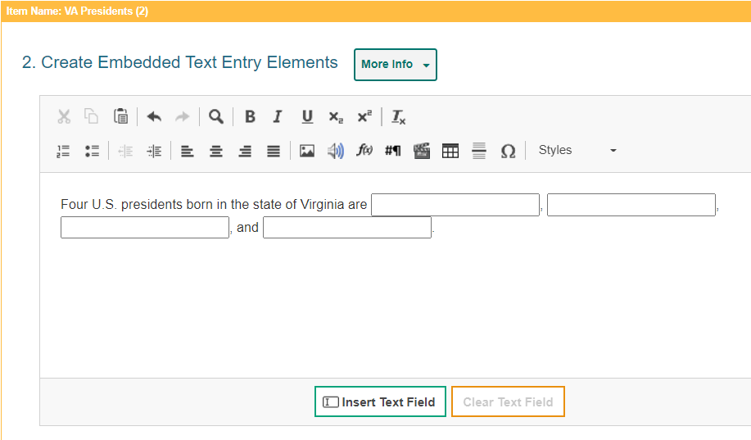
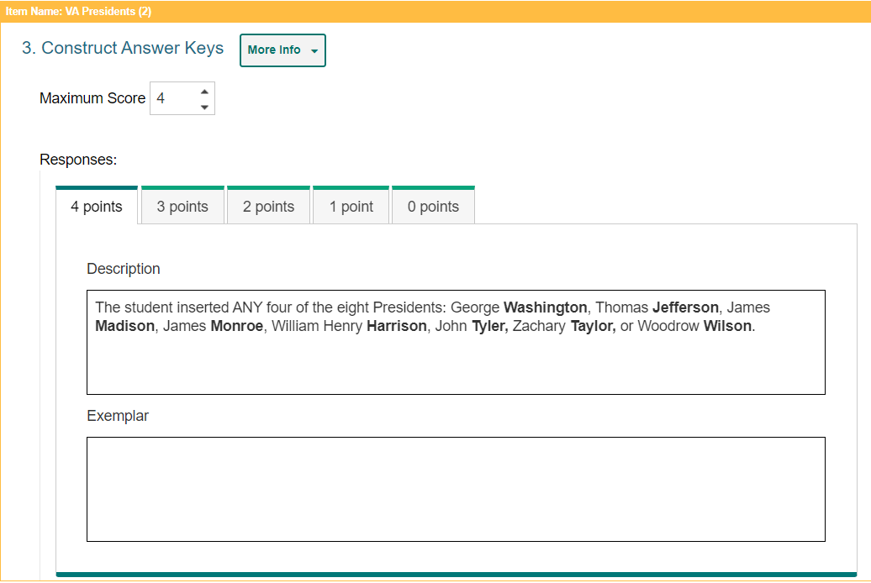
Embedded Text Entry Items
Notes:
Embedded Text Entry items require students to fill in one or more blank text boxes in a sentence by typing a response in the provided boxes. For example, an Embedded Text Entry item can provide a sentence with a missing word and ask students to fill in the blank with the appropriate vocabulary word that they learned in English class. These items must be scored by a user in the Reporting system.
In the Compose Item Prompt section, replace the sample text with the item’s question or directions. You can use the toolbar to format the text and insert media elements.
The Create Embedded Text Entry Elements section displays sample text with a blank text box. Replace this sample content with the new text content and text boxes for your item.
To insert a blank text box in the response area, click the cursor where you want to place the text box, and then click Insert Text Field. You can insert multiple text boxes, if necessary. In the Enter Text Field Properties window, specify the length of the blank text box. If you need to remove a blank text box from the response area, click the box, and then click Clear Text Field.
In the Construct Answer Keys section, enter the item’s highest possible score in the Maximum Score field. Fill out the rubric for the correct, full-credit response for the item. In the Description field, describe how a student must respond to the item in order to earn full credit. In the Exemplar field, enter an example of a response that would earn full credit. Note that the template automatically creates a rubric tab for each possible score a student can earn, based on the maximum score. To fill out any additional rubrics for the item, click the tab for that rubric and enter a description and exemplar for the rubric’s score.

Slide 39
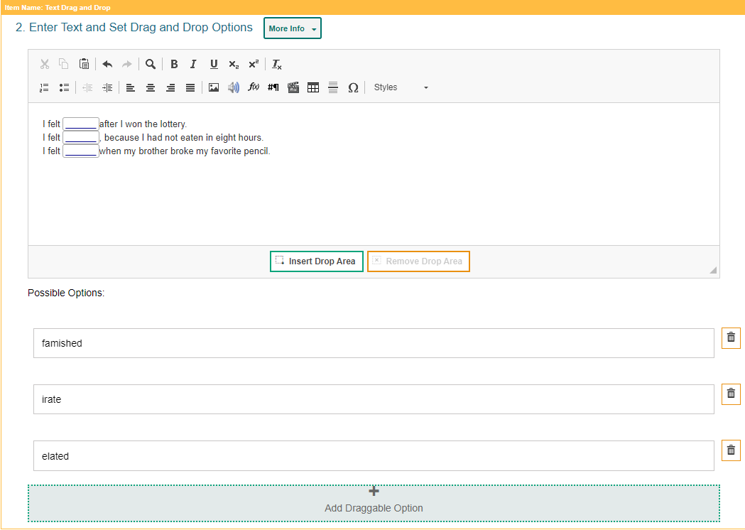
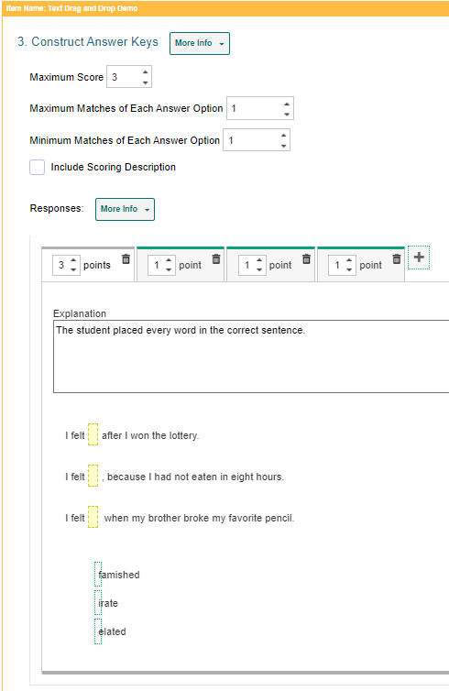
Text Drag and Drop Items
Notes:
Text Drag and Drop items require students to fill in one or more blank "drop" boxes in a sentence or paragraph by dragging response options into those boxes from a word bank. For example, a Text Drag and Drop item can provide a sentence with a missing word and ask students to fill in the blank with a vocabulary word from the provided word bank.
In the Compose Item Prompt section, replace the sample text with the item’s question or directions.
The Enter Text and Set Drag and Drop Options section displays sample text content, including a blank drop box. Replace this sample content with the new text content and the blank text boxes for your item.
To insert a blank drop box in the response area, click where you want to place the drop box, and then click Insert Drop Area. You can insert multiple drop boxes, if necessary. If you need to remove a blank drop box from the response area, select the box and click Clear Drop Area.
The template displays sample word bank options below the text box. You can click these answer options to replace the sample text with the text that students will drag into the drop boxes. To create additional answer options, click Add Draggable Option and enter the content for that answer option in the box that appears.
In the Construct Answer Keys section, enter the item’s highest possible score in the Maximum Score field. Optionally, you can set the maximum number of times students can drag each answer option into a drop box by entering the value in the Maximum Matches of Each Answer Option field. If you enter a number greater than 1, students will be able to reuse each word bank option in multiple drop boxes. Also optionally, you can require students to use each answer option a certain number of times. To do so, enter the required value in the Minimum Matches of Each Answer Option field. Students will not be able to complete the item until they have used each answer option the specified number of times.
To create answer keys for the item, do the following. In the Points field, enter the score for a correct or partially correct response. If a sample response is already entered, you may need to drag it out of the response area first. In the provided response area, drag the answer options into the drop boxes required in order to earn the score you entered in the Points field.

Slide 40
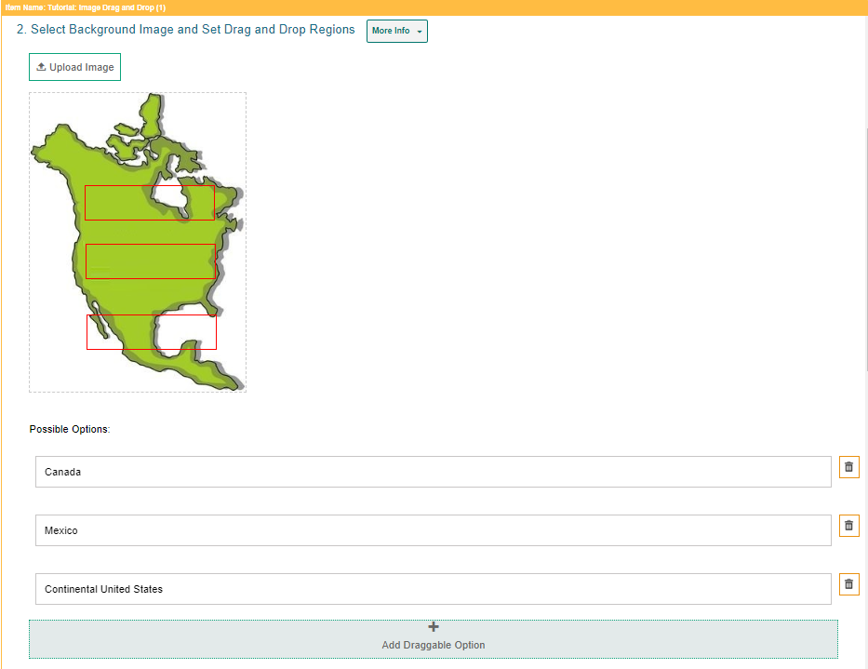
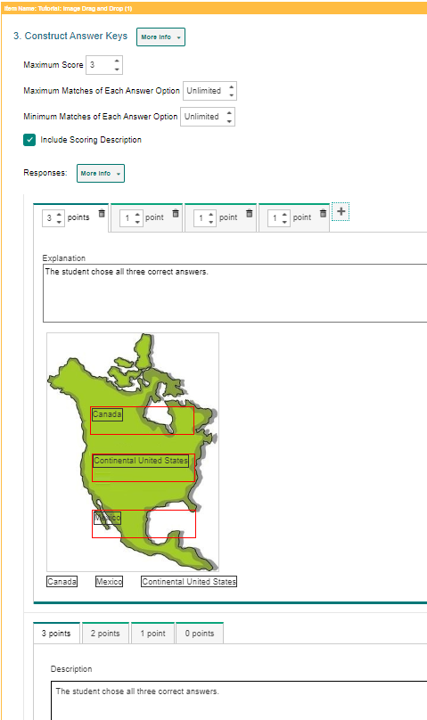
Image Drag and Drop Items
Notes:
Image Drag and Drop items require students to fill in the blank "drop" boxes on an image by dragging response options into those boxes from a word bank. You can specify the size and location of the drop boxes where students drag their answers. For example, an Image Drag and Drop item can provide a map of the Northern Hemisphere and ask students to place country names on the map using a provided word bank.
First, in the Compose Item Prompt section, replace the sample text with the item’s question or directions. You can use the toolbar to format the text and insert media elements. In the Select Background Image and Set Drag and Drop Regions section, click Upload Image. In the Image Properties window, click Browse Server. If the image you want to use for the item is already available in the File Manager window, select it and click Add to Item. You can use the search bar in the corner to search for an image by its file name. If the image you want to use is not available in the File Manager window, click Upload File and select an image file from your computer. Then select the image and click Add to Item. The image must be 600×600 pixels or smaller and under 1.5 MB. The file may take a moment to upload.
To add the drop box areas to the image, do the following. Click the image once to set the first corner of the selectable rectangle, then click one more time where you want to set its opposite corner (do not click and drag). A red box appears, but this will not be visible to students. To move a drop box region, click that box and drag it to the desired location on the image. You can copy or delete a drop box region by selecting the box and then clicking Copy or Delete.
The item template displays sample answer options below the background image. You can click these answer options to replace the sample text with the new text or image that students will be able to drag into the drop boxes. If you want to create additional answer options, click Add Draggable Option and enter the content for that answer option in the box that appears. In the Construct Answer Keys section, enter the item’s highest possible score in the Maximum Score field.
If you want to limit how many times students can use each answer option in the word bank, enter the desired limit in the Maximum Matches of Each Answer Option field. If you enter a number greater than 1, students will be able to reuse each option in multiple drop boxes. If you want to require students to use each answer option a certain number of times, enter a value in the Minimum Matches of Each Answer Option field. Students will not be able to finish the item until they have used each response option the specified number of times.
To create answer keys for the item, do the following. In the Points field, enter the score for a correct or partially correct response. Note that if a sample response is already entered, you may need to drag it out of the response area first. Then, in the provided response area, drag the response options into the drop boxes required to earn the score you entered in the Points field.
More information on how to add images to items is located on slides 27–37.

Slide 41
Table Match Items
Notes:
Table Match interactions provide two sets of match options in a table, with one set listed in columns and the other set listed in rows. Students match options in the columns to options in the rows by marking checkboxes in the cells where they intersect. In the example shown, the Table Match item lists a set of numbers in the rows and a set of properties in the columns (such as odd, even, positive, and negative), and students must select the properties that apply to each number.
To fill out the template, in the Compose Item Prompt section, replace the sample text with the item’s question or directions. You can use the toolbar to format the text and insert media elements.
The Create Table Match Options section displays a sample table. You can modify the match options that appear in each column header and row header. You can also modify the number of rows and columns that appear in the table.
To enter a caption for this table, click the text box above the table and type the caption. To enter match options in the table, click inside the row headers and column headers, and then replace the sample text with the content for the match options.
To modify the number of rows in the table, click the table rows button in the toolbar and select an option from the menu that appears. You can also right-click a row and select a menu option.
To modify the number of columns in the table, click the table columns button in the toolbar and select an option from the menu that appears. You can also right-click a column and select a menu option.
In the Construct Answer Keys section, enter the item’s highest possible score in the Maximum Score field. To set restrictions on the matches a student can make, do the following. In the Minimum Number of Total Matches field, enter the minimum number of checkboxes students must mark in the entire table. In the Maximum Number of Total Matches field, enter the maximum number of checkboxes students can mark in the entire table. In the Maximum Number of Checked Cells in Each Row field, enter the maximum number of checkboxes students can mark in any row. In the Maximum Number of Checked Cells in Each Column field, enter the maximum number of checkboxes students can mark in any column.
To create answer keys for the item, do the following: First, in the Points field, enter the score for a correct or partially correct response. Note that if a sample response is already entered, you may need to clear the checkboxes first. Then, in the provided response area, mark the checkboxes in the table cells that students would need to select in order to earn the score you entered in the Points field.

Slide 42
Equation Response Items
Notes:
Equation Response items require students to use an on-screen keypad or their physical keyboard to enter a mathematical expression or equation in the response area. For example, an Equation item can provide an algebraic equation and ask students to solve for x.
In the Compose Item Prompt section, replace the sample text with the item’s question or directions. You can use the Add Math Equation button in the toolbar to insert a formula.
In the Select Equation Keypad section, select an option from the Equation Preset dropdown to determine which buttons will be available on the student’s keypad.
The keypad in this section displays the buttons associated with the selected Equation Preset type. All keypads include Back, Next, Undo, Redo, and Delete buttons at the top.
In the Construct Answer Keys section, enter the item’s highest possible score in the Maximum Score field.
Optionally, to set the item to automatically simplify the student’s entered response, set the Simplify Response toggle to Yes.
To create answer keys for the item, do the following. First, in the Points field, enter the score for a correct or partially correct response. If a sample response is already entered, you may need to clear the response area first. In the provided response area, use the keypad to enter the mathematical expression that students would input in order to earn the score you entered in the Points field. After entering a fraction, exponent, or root, you may need to click the right arrow button in order to enter additional characters.

Slide 43
Multi-Part Items that Combine Item Types
Combine two to four item types into a single item.
If any item is hand-scored, or the Multi-Part item combines more than two parts, the Multi-Part item must be handscored.
Create a separate prompt and response area for each part of the Multi-Part item, but only one answer key.
Notes:
Here is a list of some factors associated with the Multi-Part item. The template allows you to combine two to four item types into a single item. When creating a Multi-Part item, you can choose how it will be scored, how many parts it includes, and which item type is used for each part. For example, a Multi-Part item with a Multiple Choice/Select part and an Edit Task part can ask students whether a statement is true or false, and then ask them to correct the part of the statement that is false.
If a Multi-Part item includes only two parts and both item types are machine-scored, then the Multi-Part item itself can be machine-scored. If a Multi-Part item includes more than two parts, or if any of the included item types are hand-scored, then the Multi-Part item must be scored by hand.
The templates for Multi-Part items require you to create a separate prompt and response area for each part of the item, but only one answer key is needed for the whole item. Some of the settings and fields that usually appear in the section for constructing answer keys will appear in the section for constructing response areas in Multi-Part item templates.

Slide 44
Multi-Part Item Options
Notes:
The Multi-Part item template initiates with a page where you will select options under Scoring Method, Number of Parts to Create, parts of the Multi-Part item, and a button “Create Multi-Part Item.” After you click that button, the actual steps involved depend on which item type you selected for the first part of the item. For more information, you can consult the instructions for each item type in the Filling Out Item Templates section of the Authoring User Guide.

Slide 45
Create a Test with the Test Generator Wizard
Notes:
This section covers how to create a test automatically using the Test Generator Wizard.

Slide 46
Access the Test Generator Wizard
Notes:
To access the Test Generator Wizard, click the link on the card on the Authoring homepage. Or, if you have the Tests content tab open, click the Test Generator Wizard tab in the Tests toolbar.

Slide 47
Steps in the Process/Step 1—Get Started
Notes:
There are three required steps in the process of generating a test with the Test Generator Wizard. They are: Step 1: Get Started, where you will enter a name for your test, and select a grade and subject from the drop-down lists. Step 2: Select Standards, where you will align the test to one or more standards, and Step 3: Item Distribution, where you will assign an item count to each standard. Then, you can use the Optional Settings to assign test properties and tools.
The Wizard will automatically build the test based on your chosen parameters.
You can also generate a test based on an existing template, in which the properties, standards, and item counts are preselected. To do this, use the My Templates button at the upper-right corner of the page.
As you make your selections they populate under Selected Options in the right side of the page. Click the red Next Step button to progress.

Slide 48
Step 2—Select Standards
Notes:
In the Select Standards panel, use the Guided and Quick Key options to select which standards the test should assess. Click the Align button and the standards appear in the Selected Options panel on the right. Repeat this step until you have added every standard you want to include in the test. Then click Next Step.

Slide 49
Step 3—Item Distribution
Notes:
The Item Distribution panel appears, displaying the number of items available for each standard you selected. Enter a number in the # to Add to Test field or use the arrow buttons to select a number in each field. The item count updates in the Selected Options panel.
You have two options at this point:
You can generate the test by clicking the Generate Test button, or
You can customize the tools and other available test properties by clicking the Optional Test Properties button.
Test properties include various options, such as the description, keywords, security rules, and test tools.

Slide 50
Confirmation Message
Notes:
When you click Generate Test the confirmation screen confirms that the test has been generated and it reminds you that by clicking the Review Test button you can use the test builder to add and remove items, just like you would for a test built manually.
Optional: If you want to reuse the selected standards and item counts as a template for generating future tests, click Save These Settings as a Template. Tests generated from a template use the same properties, standards, and item counts as the original test, but the actual items in it may differ. Refer to the Authoring User Guide for detailed instructions on using a template.

Slide 51
Review the Test Using the Test Builder
Notes:
Here is the test builder page for the Sample Test. Selected items in the Layout panel on the left side of the page are displayed in the Preview portion of the page. You can delete or add items by using the trash can button or the plus signs displayed as you scroll down the Layout panel. This process is explained in the next section, Building a Test Manually.

Slide 52
Create a Test Manually
Notes:
This section covers the common tasks or actions you can take on existing tests.

Slide 53
Create a New Test - Manually
Tests Content Tab
Test Builder Page
Dashboard Quick Link
Notes:
To create a new test, open the Tests content tab and click the green Create New Test button, or select the Create New Test link from the Tests card on the dashboard. The test builder page appears, showing two options for adding items to the test: Add from Library or Create from Template.
To add an item from one of your libraries, click that button. To create a new item using a template, click Create from Template link and build the item the same way you would when using the Item Builder page.

Slide 54
Add an Item from a Library
Notes:
When adding an item from a library, you may need to apply at least one filter from the Item Filters panel in order to display the available items. You can also search for specific items by their item properties (such as their name, keywords, and aligned standards). Select the library item you wish to add.

Slide 55
Add an Item from a Library (continued)
Notes:
The item preview window displays the option to Add Item to Test.

Slide 56
Editing Item Content when Creating a Test
Notes:
Continue to add items from the results table or click the Add New Item button to return to the Item Filters panel. A new thumbnail appears in the Layout panel for each item you add.
You can rearrange the items in your tests by clicking their thumbnails and then clicking the Up and Down arrow icons that appear to the left of the trash can button.

Slide 57
Test Properties Menu/Preview Item
Notes:
At any point while creating your test, you can enter details like: the test’s name, description, grade, keywords, security, and test tools (calculator, periodic table, thesaurus and dictionary). Using the Test Properties button in the test toolbar, make your selections, and click Close. Please note that the Periodic Table, Thesaurus, and Dictionary tools are available to use in teacher-authored tests but will not be available in the summative tests.
To see what your test will look like to students, click Preview Test in the test toolbar. You can enter sample responses to items and click Item Score to make sure the items are being scored correctly.

Slide 58
Test Properties Menu/Preview Item
Notes:
At any point in creating your test you can enter details such as the test’s name, description, grade, keywords, security, and test tools (calculator, periodic table, thesaurus and dictionary). Use the Test Properties button in the test toolbar, make your selections, and click Close.
To see what your test will look like to students, click Preview Test in the test toolbar. You can enter sample responses to items and click Item Score to make sure the items are being scored correctly.

Slide 59
How to Publish a Test for Online Administration
Notes:
You must publish a test before you can administer it to students.

Slide 60
Publish a Test
Test Administration System:
Test Selection Window
Notes:
To publish the test, click the Publish Test. Button in the Tests toolbar. If this button is not clickable, make sure the test does not include any blank pages and that you have saved changed to each item on the test.
After publishing a test, you can add it to your test sessions by selecting it from the Test Selection window in the Test Administration System. You can administer your own tests, shared tests, and tests from a shared test library.

Slide 61
Change Test Administration Dates
Notes:
Depending on your user role, you may have the ability to change the test administration dates. Click the date range link in the Test Window column. Then use the fields in the Set Test Window to assign a testing window.

Slide 62
How to Generate Test Booklets for Paper Administration
Notes:
You can build a test booklet for paper administration when students cannot test on a computer.

Slide 63
Build a Test Booklet
Notes:
To build a test booklet for paper administration, use the Tests tab. Click the Build Booklet button in the Test Actions Section.

Slide 64
Test Booklet Generator
Notes:
The Test Booklet Generator window opens, walking you through the steps to customize the booklet. The booklet file will be sent to the Secure File Center in the banner, where you can download and print it.

Slide 65
How to Work with the Items and Tests Available to You
Notes:
This section explains how to work with your items, tests, and standards using the toolbars and filters. It explains how to edit, copy, label, and archive your content on the tabs. It provides instructions for authorized users to create subjects that may be aligned with content in Authoring.

Slide 66
How to Use Toolbars
Notes:
When you click a content tab for Items or Tests, a toolbar displays allowing you to perform various actions on your items and tests. The actions available depend on status, linked tests and the library it belongs to.
The next slide describes some of the toolbar and table actions you can perform using each content tab.

Slide 67
How to Work with Items Available to You
Find Items
Perform Actions on Items
Edit Items
Preview Items
Duplicate Items
Label Items
Share an Item
Archive or Delete an Item
Notes:
In this section, we cover how to perform various actions on items available to you. The actions you can perform may depend on the item’s status and library.

Slide 68
How to Manage Your Available Items and Tests
All Authoring users can perform the following actions on the Items and Tests tabs:
Preview content to see how it will appear to students in the Test Administration system.
• Edit the content of any items and tests with a Draft status.
• Copy items and tests that you want to modify without affecting the original version.
Label content so it is easier to organize and locate.
Save an item as a PDF so you can print it out.
Build a test booklet that can be administered to students on paper.
Archive items and tests that you don’t need to use anymore.
Share items and tests you want other educators to co-author or use for themselves.
Content may be available for display or presentation in both English and Spanish.
District- and school-level users can perform the following actions:
• Set administration rules for when tests will be available in the Test Administration System.
A
Notes:
All Authoring users can perform the following actions on the items and tests tabs:
Preview contents to see how it will appear to students in the Test Administration system.
• Edit the content of any items and tests with a Draft status.
• Copy items and tests that you want to modify without affecting the original version.
Label content so it is easier to organize and locate.
Save an item as a PDF so you can print it out.
Build a test booklet that can be administered to students on paper.
• Archive content that you don’t need to use anymore.
Share content you want other educators to co-author or use for themselves.
District- and school-level users can perform the following actions:
Set administration rules for shared tests, including who can administer a test and when it will be available in the Test Administration System.

Slide 69
Find Items Available to You
Notes:
Pre-existing useable items are organized into libraries that are located on the Item Filters panel. Click the Show Filters button on the Dashboard to open it and expand the arrow next to the Libraries option. The libraries you see are determined by your state’s assessment program. Make your selections from those listed and click Apply Filters to display a table of results.
You can select other options, such as subject, grade, and standard from the Item Filter panel to further refine your search. A sample panel is shown here on the right.

Slide 70
Find Items by Standard (Quick Link)
Notes:
To search for items aligned to a certain standard, you can use the quick link “Find Items by Standard.” In the Standard field of the Item Filters panel, type in a few letters of the standard key, such as a number or a letter. A list of possible matches displays in a drop-down list. Any standards you select will display above the search box. Click Apply Filters. The results table will display the items aligned to the selected standards.

Slide 71
Perform Actions on Items
Items Toolbar
Edit button
Dotted Menu
Notes:
Here is a table of results generated with four filters, the Items I Created library, the Checkpoint Math Items library, the subject of Mathematics, and Grade 3. You can use the toolbar and table menus to perform various actions on items.
You can see that many of the action features are displayed in both the toolbar and the dotted menu. To perform the same action on multiple items, mark the checkbox next to the dotted menu and use the action button in the toolbar. To perform an action on an individual item, open the dotted menu and select the option from the list.
The next slide describes the actions you may perform.

Slide 72
Possible Actions for Items
Edit your items that haven’t been published yet.
Preview an item to see how it will appear to students in the Test Delivery System.
Duplicate items that you want to modify without affecting the original version.
Label items so it is easier to organize and locate on your content tab tables.
Save an item as a PDF so you can print it out.
Share items that you want other educators to co-author or use for themselves.
Archive or delete items that you don’t need to use anymore.
Notes:
Here is a list of the actions you can take on items. The actions you can perform may depend on the item’s status and library. The buttons shown here display in the toolbar above the results table or in the table menu.
This section covers these actions in the order that they appear in this list.

Slide 73
Edit Items
Notes:
You can make changes to any items you created that have a Draft status. You cannot edit Published items. When another educator shares an item with you, you may only edit its content if you were given editing permission by the original author. If you cannot edit an item, you may create a copy of it and make changes to the copy.
To make changes to your items, open the content tab and click the Edit button under the name of the item. The corresponding builder page will appear. When editing items, you may also need to click the Edit button in the item toolbar.

Slide 74
Preview Items
Notes:
You can preview your items and tests to see how they will appear to students in the Test Delivery System. Open the Items tab and filter to find the item you wish to edit. Select Preview from the dotted menu or use the Preview button in the banner. The properties for each item are found by expanding the Item Details section on the left.
Optionally, you can enter responses for machine-scored items and click Item Score to verify the item is being scored accurately. A pop-up window will appear, indicating which answer key matches the entered response.

Slide 75
Duplicate Items
Notes:
You can create duplicates of items that you wish to modify without affecting the original version. For example, if you want to edit a Published item or a shared item that you don’t have permission to edit, you can copy that item and make edits to the duplicate version.
You may not have permission to duplicate items in some libraries. Editing the items on a test duplicate will affect the items on the original test, and vice versa.
Open the Items tab and filter to find the item or items you wish to duplicate. Select Duplicate from the dotted menu or use the Duplicate button in the banner.

Slide 76
Label Items
Notes:
You can create labels and add them to items that you want to organize on the content tab. Open the Items tab and mark the checkbox for each item you wish to label, or to label an individual item, use the dotted menu option. Click the Label button in the toolbar. The Apply Label window appears. You can search for a label, or you can select a sub-label from a drop-down menu and click the Apply button.
After adding labels to your items, you can use the Labels menu in the filter panel on the left of the Items tab to easily view the items with the selected label. You can create labels for any content in your libraries, but these labels appear on your screen only. They are unique to your account and do not display for anyone else the content is shared with.
Optional: To modify a label, select the My Labels quick link from the Dashboard. Click Edit next to the label's name. Make the necessary changes and then click Done.

Slide 77
Save an Item as a PDF
Notes:
If you want to create a printable version of an item, you can save it as a PDF file. When saving items as a PDF, you can also choose to include the item’s scoring guidelines in the printout. If available, PDF files display items with paper-friendly formatting and display an item’s properties.
To save an item as a PDF, open the Items tab and mark the checkbox for each item you wish to save as a PDF and then click Save as PDF above the table. However, you may need to apply filters first. If you select multiple items, they will be saved as a single PDF file. You may not be able to save a PDF for a large selection of items because the number of items at which issues can arise depends on the items’ content.
Click Generate PDF. The file will be added to the Secure File Center where you can download it for 30 days.

Slide 78
Archive and Delete Items
Content Type | Archive and Delete Permissions
Draft Items | Draft items can be deleted if they are not linked to any tests. Draft items cannot be deleted while they are linked to a test. Draft items cannot be archived.
Published Items | Published items cannot be deleted. Published items cannot be archived if they are linked to a published test. Published items can be archived only if every test they are linked to is also archived.
Notes:
You can archive and delete items that you do not wish to use anymore. Archived and deleted items cannot be shared, added to tests, or associated with other content. They will also be removed from your content tab tables. Your ability to archive and delete items depends on its status and other conditions explained in this table.
Mark the checkbox for the items you want to archive or delete and select the appropriate button in the banner. A pop-up window displays along with a pre-populated command related to the items selected. Click OK.
If you wish to restore an archived item, set the Status filter to Archived, then mark the checkbox for the item or items you wish to use again and click Restore in the banner.

Slide 79
How to Share Your Items & Tests with Other Educators
Notes:
This section explains how to share your items and tests with others.

Slide 80
Share Items with Other Educators
1
3
2
4
Notes:
You can share any item in your personal library. First, open the Items tab and apply the appropriate filters. Then use the banner button or the dotted menu option to share items. The Item Sharing window will appear.
1. Search for an educator’s name or email address, or the name of a workgroup or institution. Select the recipients you want to share your content with.
2. In the Search Results, click the + symbol for each educator you wish to add as a recipient.
3. Select the specific permissions you’d like to give to each recipient. All recipients will be able to create copies of your shared content by default.
To allow a recipient to view the content, mark the View checkbox.
To allow a recipient to make edits to the shared content, mark the Edit checkbox.
To allow a recipient to publish tests containing the Draft item, mark the Publish checkbox.
4. Click Save. The shared content will now appear in the items table for the selected recipients

Slide 81
How to Share Your Tests with Others for Administration
1
Notes:
When sharing tests with other educators, you can choose to share the test with them in Authoring for collaboration purposes or in the Test Administration Site, where they can administer it to students. Begin by filtering the Tests content tab for the tests you want to share. To share an individual test, click the dotted menu to the left of the test and select Share.
1. To share multiple tests, mark the checkboxes of the tests you want to share and click the Share button in the toolbar.

Slide 82
How to Share Your Tests with Others for Administration (cont.)
2
3
5
4
6
Notes:
2. The Test Sharing window will appear. To share the test so it can be administered by other educators, mark the Share to TDS radio button.
3. Search for an educator’s name or email address or the name of a workgroup or institution. Select the recipients you want to share your content with.
4. In the Search Results, click the + symbol for each educator you wish to add as a recipient.
5. Enter or change the dates in the Administration Period fields.
6. Click Save. The tests will now appear in the Select Tests tab of TDS for the selected recipients.

Slide 83
How to Share Your Tests with Others for Collaboration
1
2
4
3
Notes:
When sharing tests with other educators for collaboration purposes:
Select the Share in Authoring radio button at the top of the Test Sharing page.
Find recipients by using the Sharing Group field and the Search for Recipients menu.
Use the Search Results column to Add recipients.
Select the specific permissions you’d like to give to each recipient. All recipients will be able to create copies of your shared content by default.
To allow a recipient to view the tests, mark the View checkbox.
To allow a recipient to make edits to the shared tests, mark the Edit checkbox.
To allow a recipient to publish the tests, mark the Publish checkbox.

Slide 84
How to Create and Join Workgroups for Sharing Content
Notes:
To make it easy to share your tests and items with the same group of educators on a regular basis, you can create a workgroup for them. You can also join other workgroups you get invited to.
1. Select My Workgroups from the Manage menu in the Authoring dashboard.
2. Click Create New Workgroup.
3. In the Workgroup Name field, enter a unique name for your group and select an Institution. In the Search to Add to Workgroup field, enter the name or email address for the user you want to add to the group. Select the name when it appears in the dropdown. Click Save.
4. To join a workgroup you have been invited to, open the Notifications menu in the banner and click Workgroup Invitations. The Manage Workgroups window appears. Click Join or Decline under the Pending Workgroup Invitations section.

Slide 85
How District- and School-Level Users Set Administration Dates
Notes:
District- and school-level users can set administration dates that specify exactly when their shared tests will be available in the recipients’ Test Administration System. Recipients will be able to access these shared tests in the Test Administration System, but they cannot view or edit them in the Authoring Tests tab.
On the Tests tab, mark the checkbox for the published test that you’d like to modify the test window for.
You can see the test Test Administration window as one of the headers
To edit the date range during which the test will be available in the Test Administration System, select the current test window displayed for that test.
When the Set Test Window page appears, add the dates that you want for the test window and select the blue Set Test Window button.

Slide 86
For More Help
You can contact the Help Desk for assistance with any technical issues you encounter. When contacting the Help Desk, please be ready to provide:
Any error messages that are appearing (including codes)
Your operating system and browser information
Your network configuration information
Your contact information for follow-up by phone or email
Any other relevant information, such as test names or content areas, student IDs, session IDs, and search criteria
For test administration or policy issues, please contact your district test coordinator.
Additional Information
ClearSight Portal
ClearSight Help Desk
Notes:
You can find the 2022-2023 Authoring User Guide and other helpful resources on your state or district assessment portal. However, if you still require assistance with troubleshooting a technical issue, you may also contact your helpdesk. When contacting your helpdesk, please be ready to provide the following information:
Any error messages that are appearing (including codes)
Your operating system and browser information
Your network configuration information
Your contact information for follow-up by phone or email
Any other relevant information, such as test names or content areas, student IDs, session IDs, and search criteria
For questions about test administration or policy issues, please contact your district test coordinator.
Thank you for taking the time to view this training module. For detailed information, consult your Authoring User Guide, located on your state portal, or contact your helpdesk.

